Slide 1
2023 Loss of Load Expectation (LOLE) 2026 Study Overview
November 2023 REAL Meeting

Slide 2
Outline
LOLE Overview
Modeling Assumptions
Analysis of LOLE Hours
Year 2026 Draft Results
Next Steps
Hourly Load Profiles

Slide 3
LOLE OVERVIEW

Slide 4
Loss of load expectation Overview
What is LOLE?
  Expected number of days per year, or hours per year, an area does not have enough capacity to meet load
What is the LOLE target?
  LOLE analysis determines the amount of capacity needed to meet a desired reliability target
  SPP currently maintains a 1 day in 10 years (1-in-10) industry practice threshold as a reliability target (equivalent to 0.1 days/year)
How is the LOLE target used?
  Establishes the area’s Planning Reserve Margin (PRM)

Slide 5
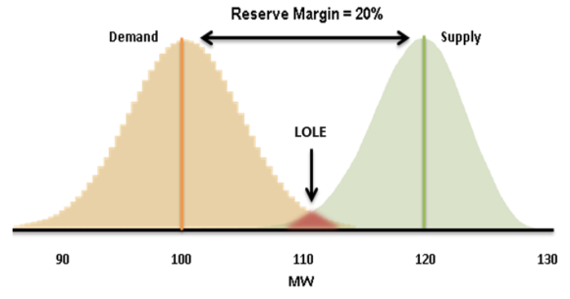
Application of lOLE
LOLE Study is performed by SPP every 2 years to assess the Planning Reserve Margin (PRM)
Probabilistic Study that analyzes the ability to reliably serve the SPP Balancing Authority Area’s forecasted Peak Demand
Evaluates each hour of the year (8,760 hours)
Uses sequential Monte-Carlo simulations (multiple iterations)
Inputs and assumptions developed by Supply Adequacy Working Group (SAWG)
Results give insight to SPP stakeholders and respective state commissions when making policy decisions related to resource adequacy
Currently the PRM is 15%
$Reserve Margin \%=\frac{Capacity − Demand}{Demand}$ x 100
𝑹𝒆𝒔𝒆𝒓𝒗𝒆 𝑴𝒂𝒓𝒈𝒊𝒏 %=(𝑪𝒂𝒑𝒂𝒄𝒊𝒕𝒚 − 𝑫𝒆𝒎𝒂𝒏𝒅)/𝑫𝒆𝒎𝒂𝒏𝒅 x 100
The measure of LOLE occurs during few hours when demand is high and supply is low, while the reliability metric target determines the LOLE tolerance of the system

Slide 6
Modeling Assumptions

Slide 7
2023 LOLE Study Assumptions
PRM impact analysis performed on Incremental cold weather outages assumption, Planned and Maintenance Outages assumption, and seasonal reliability metric application
Assumptions | 2023 Study | 2021 Study
Historical Wind, Solar, & Load Profiles | 43 Years (1980-2022) | 9 Years (2012-2020)
Planning Years | Year 3 and Year 6 (2026 and 2029) | Year 2 and Year 5 (2023 and 2026)
Reliability Metric Application | Seasonal | Annual (Summer Based)
Temperature Outages | Incremental cold weather outages applied for extreme winter temperatures | None
Demand Response Programs | Actual Program Parameters | No limits
Forced Outage Rates | GADS 2015-2022 | GADS 2015-2020
Value of Wind, Solar, and Battery in PRM Calculation | System ELCC (all weather years) | Methodology similar to ELCC
Load Forecast Uncertainty | Considered in the 43 Historical Weather year | 7 discrete standard deviation points
Determination of 1 day in 10 year threshold | Perfect Negative Generation | Generation Removal

Slide 8
Year 2026 Modeled Generation and peak demand
Fuel Type | Modeled in 2023 LOLE Study(MW) | Summer Accredited in PRM Calculation (MW) | Winter Accredited in PRM Calculation (MW) | Modeled in 2021 LOLE Study (MW)
Natural Gas and Other Gases | 32,733 | 32,325 | 32,733 | 30,848
Coal | 20,422 | 20,422 | 20,422 | 20,887
Hydro | 3,252 | 3,252 | 3,252 | 3,173
Nuclear | 1,948 | 1,948 | 1,948 | 1,948
Petroleum | 1,805 | 1,777 | 1,805 | 1,820
Battery | 426 | 426 (100%) | 354 (83%) | 0
Wind | 37,964 | 5,413 (14%) | 9,576 (25%) | 30,556
Solar | 4,828 | 2,867 (59%) | 521 (10%) | 238
Demand Response | 1,850 | 1,850 | 1,422 | 838
Firm External Imports | 2,100 | 2,100 | 2,071 | 2,009
2026 accredited capacity values
%’s represent accreditation based on System ELCC methodology
2023 LOLE Study Peak Demand | Summer (MW) | Winter (MW)
Non-Coincident Peak (NCP) | 58,028 | 47,822
2026 forecasted demand values in model simulation and PRM calculation

Slide 9
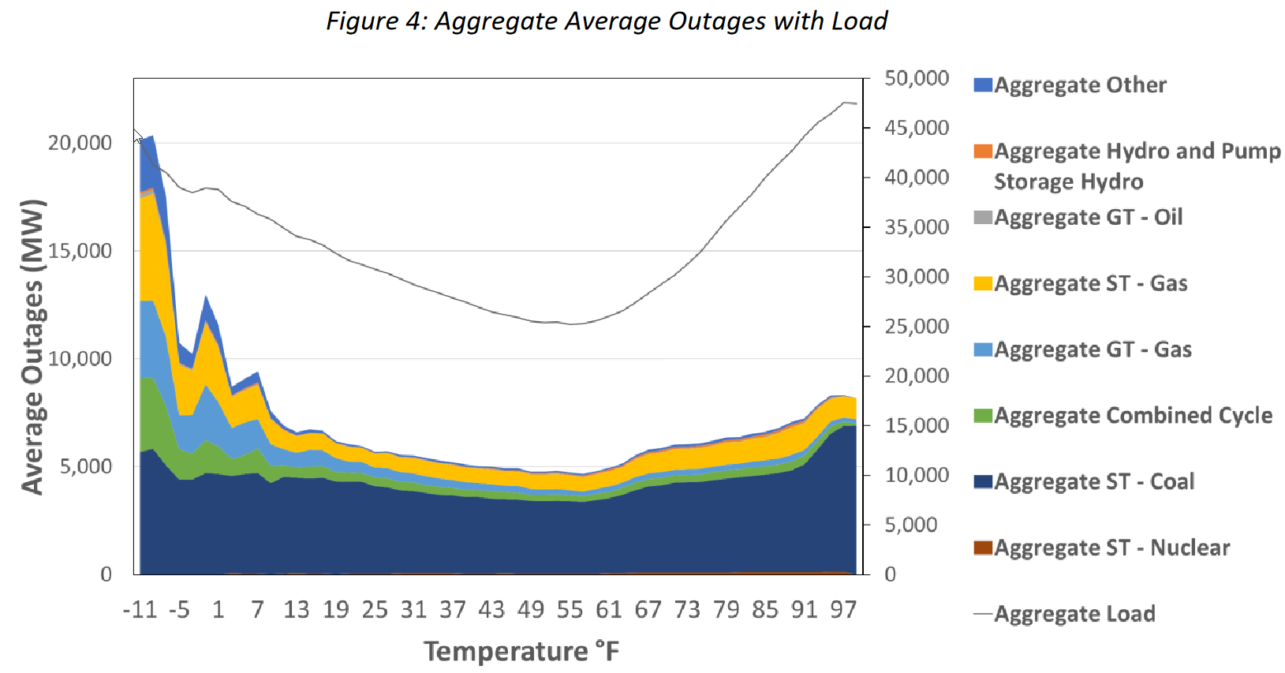
SIR227 RESOURCE PLANNING & AVAILABILITY 2.7
2023 LOLE study drivers:
Derive a level of planned outages from historical analysis that occur during summer and winter seasons
Analyze outage trends driven by temperature
Analyze outage trends driven by common mode outage failures
Common mode examples could include:
Simultaneous gas transportation limitations
Simultaneous gas line pumping station failures
Simultaneous loss of capacity due to temperature extremes, flooding and drought conditions
Simultaneous loss of facilities due to transmission outages
Simultaneous loss of output from renewable facilities (e.g. ‘icing’ conditions)
Model extreme weather event correlations LOLE study for RPA 2.6 to capture common mode outages and outage thresholds driven by extreme temperature
Shows the temperature impacts on forced outages considered in the 2023 LOLE Study

Slide 10
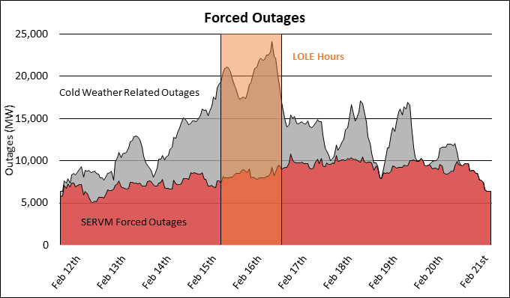
Application of incremental cold-weather outages
SERVM simulations show consistency with what occurred during URI based on the aggregation of Cold Weather Related Outages and Forced Outages
Historical forced outages are based on the EFOR methodology

Slide 11
Planned & maintenance outage modeling
Values modeled contain maintenance & planned outages as reported through NERC GADS
Event durations modeled in SERVM based upon historical GADS information to allow increase in model variance
Annual maintenance rates calculated using 2015 to 2022 NERC GADS planned and maintenance outages
Outage events modeled on an individual unit level
Each unit has specific rates & historical events
Units with missing historical data were supplemented by a similar facility based upon unit size, type, and age
SERVM software schedules outages by historical weather-year
Optimizes schedule dependent upon historical peak daily load shapes

Slide 12
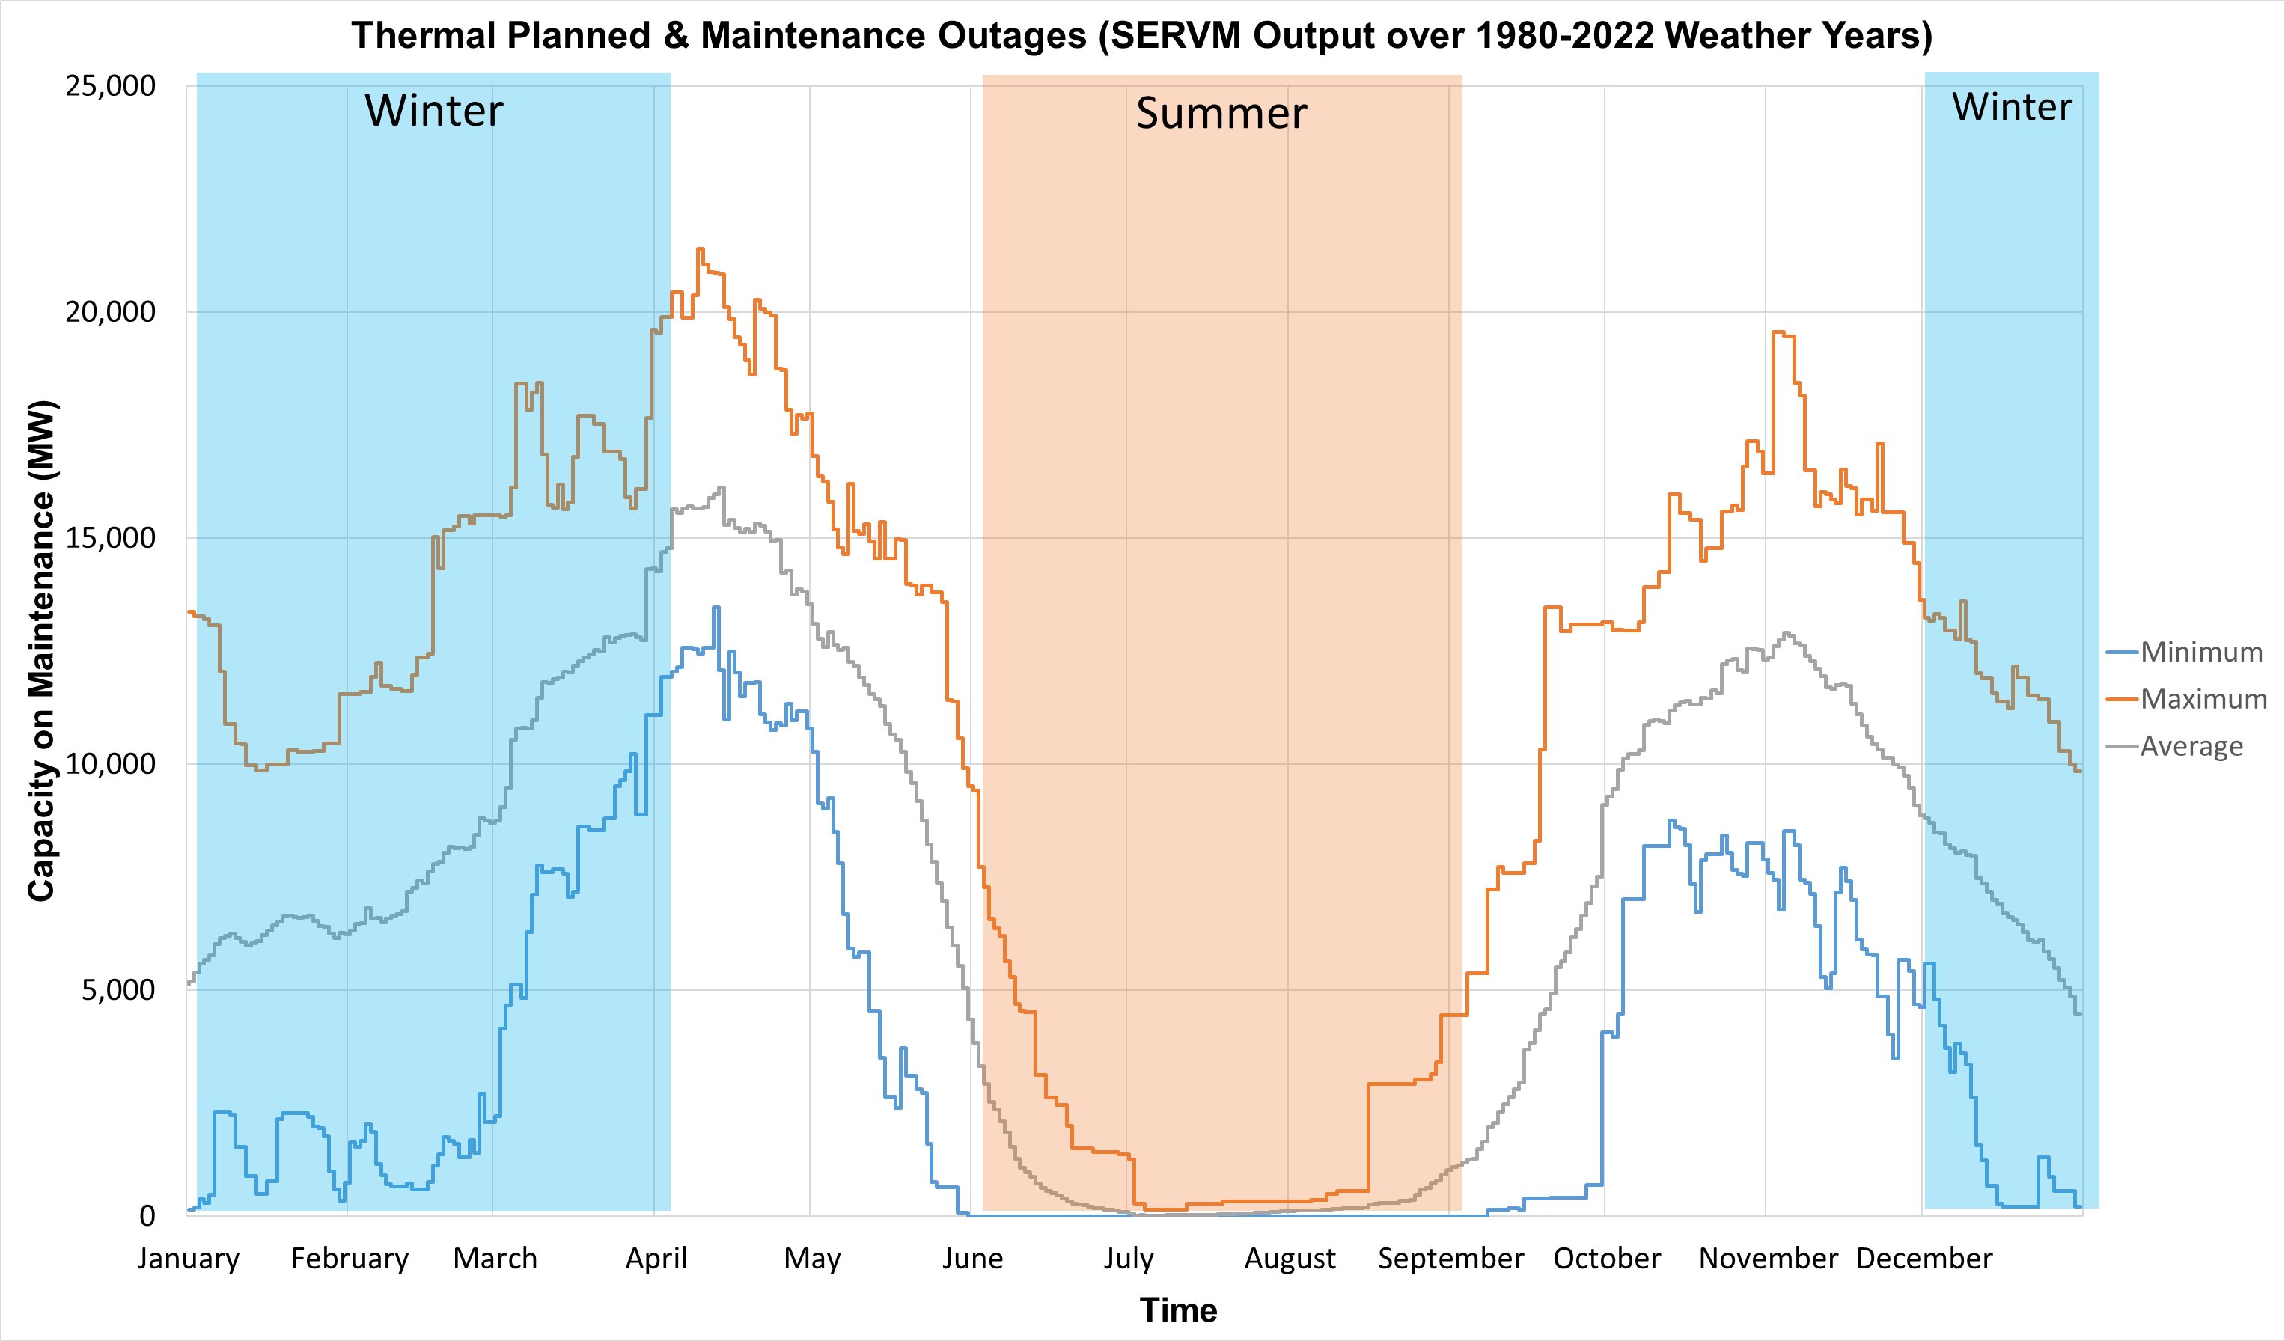
Planned & maintenance outages scheduled by servm
The highest and lowest outage variance is driven by difference in weather years. Lower P&M outages would mostly occur during LOLE risk hours
SERVM mainly schedules P&M outages from an SPP perspective outside of the Summer Season
The highest and lowest outage variance is driven by difference in weather years. Lower P&M outages would mostly occur during LOLE risk hours

Slide 13
Hourly load profiles

Slide 14
Load profile assumptions
Historical weather-years (1980-2022) were modeled
Each historical year was proportionally scaled to a forecasted Peak Demand for years 2026 and 2029
Load shapes, wind, and solar temperature correlation synthesized to existing weather years
Peak Load forecasted values were based upon the 2023 Resource Adequacy Workbook submittal process
Forecasted values applied on a seasonal level

Slide 15
Non-coincidental Peak (NCP) to coincidental peak (CP) translation
2023 Resource Adequacy Workbook submission
Load Responsible Entities (LREs) and their diversity into zones
Determined Summer and Winter Diversity Factor
Set the forecast average to all weather years

Slide 16
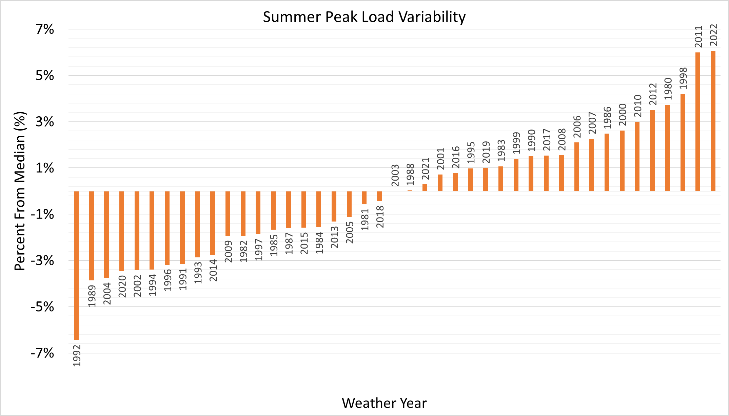

Slide 17
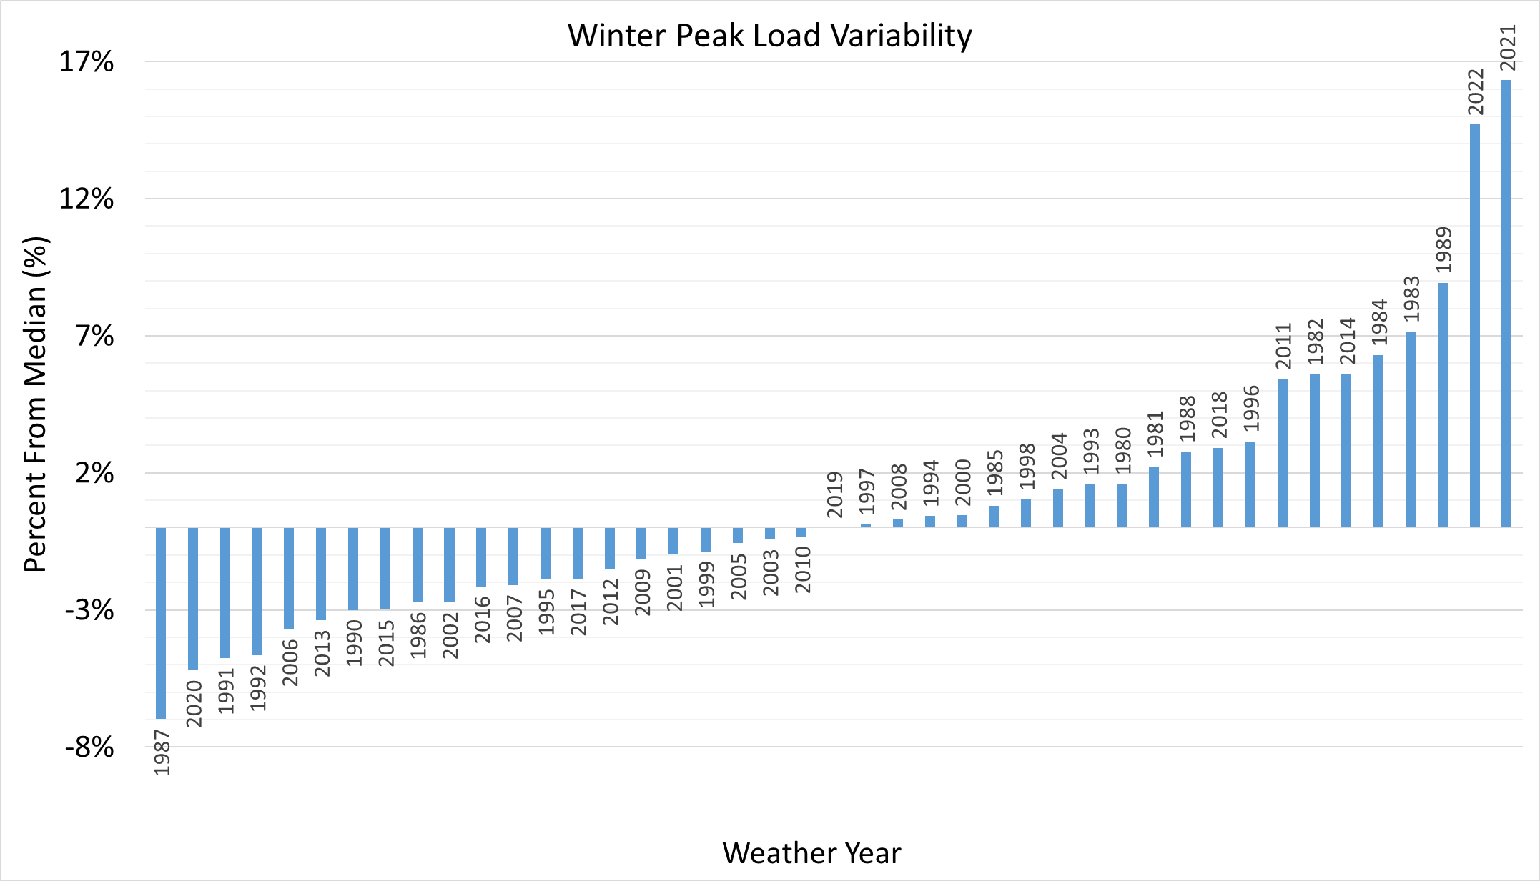

Slide 18
Analysis of LOLE Hours

Slide 19
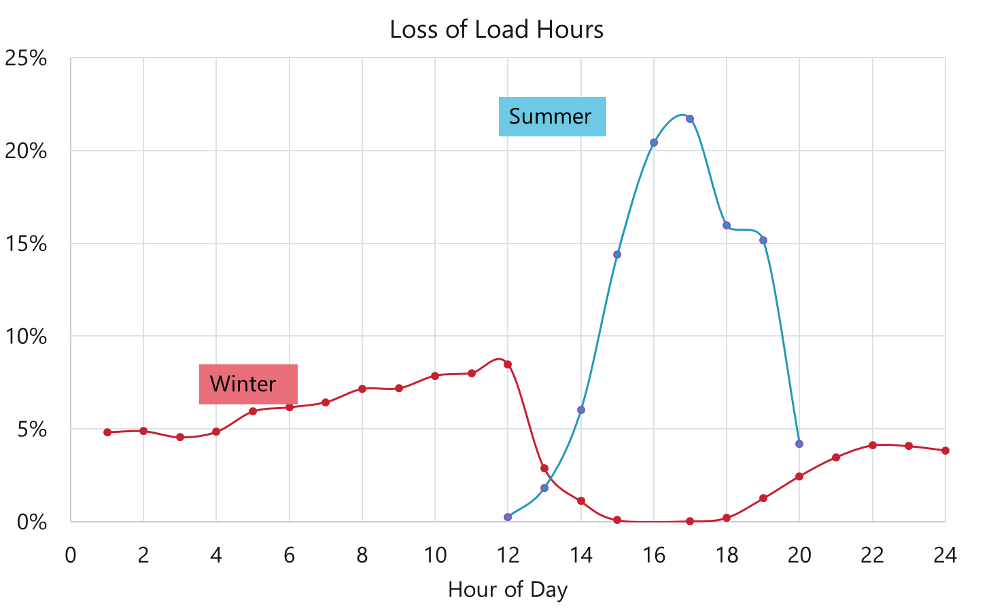
Hours and years contributing to Seasonal LOLE
Weather Year | Percent Contribution of Summer LOLE
1980 | 31%
1986 | 1%
1999 | 1%
2001 | 5%
2006 | 5%
2011 | 15%
2012 | 41%
LOLE risk hours are different between summer and winter seasons
Weather Year | Percent Contribution of Winter LOLE
1983 | 1%
1989 | 9%
2021 | 90%
Season | Hours Driving LOLE | Percent of Simulated Hours
Winter | 64 | 0.05%
Summer | 82 | 0.07%

Slide 20
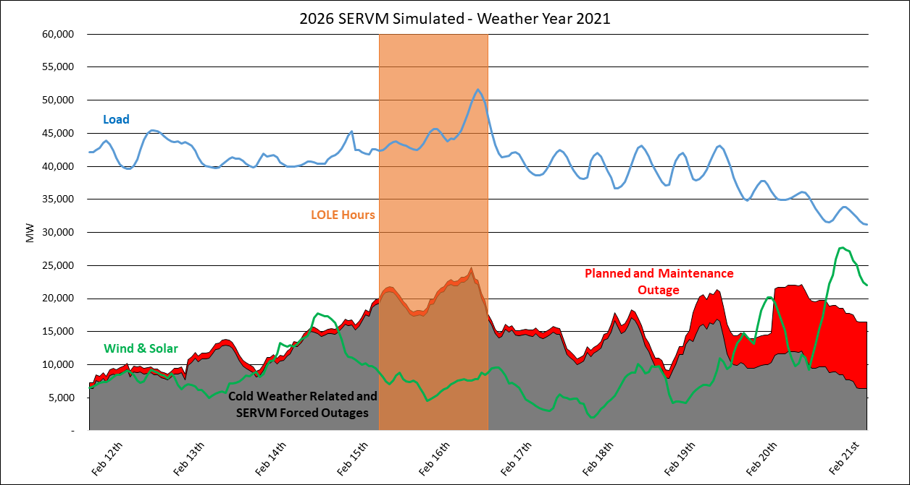
SERVM simulation showing correlation of load, wind and solar resources and outages and Loss of Load Event hours, related to URI

Slide 21
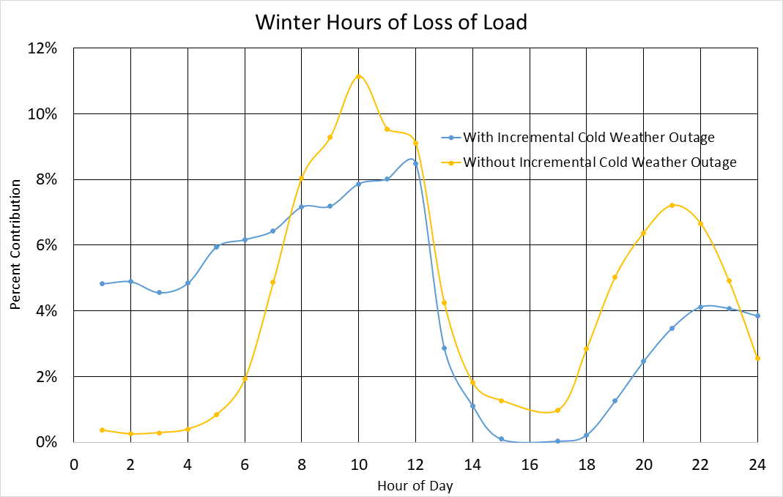
Incremental Cold weather outages impacts on loss of load hours
Incremental cold weather outages shift risk hours of the day to lower temperature hours while considering effects from load and variable energy resources

Slide 22
Outages during winter lole hours
Incremental Cold Weather Outage | Minimum Winter Forced Outages Observed | Average Winter Forced Outages Observed | Maximum Winter Forced Outages Observed
Without | 5,314 | 9,747 | 15,301
With | 14,110 | 20,034 | 25,643
Incremental Cold Weather Outage | Minimum Winter Planned & Maintenance Outages Observed | Average Winter Planned & Maintenance Outages Observed | Maximum Winter Planned & Maintenance Outages Observed
Without | 214 | 1,654 | 15,244
With | 214 | 677 | 3,606

Slide 23
Year 2026 Draft results discussion

Slide 24

Questions for REAL
Incremental cold weather outages were added this year. Based on recent policies, how much resource improvement should we expect if another Uri-type event occurs?
Cold Weather Outage Improvements

Slide 25



Questions for REAL
Seasonal Balance of Risk
How much risk do we plan for in the winter vs. summer?
Do we maintain strictly 1-in-10 annually?
Of the annual LOLE (0.1 LOLE), do we balance the LOLE across the year (0.05 LOLE in winter and 0.05 in summer)?

Slide 26

Questions for REAL
Planned and Maintenance Outages
Should planning outages be accounted for in PRM?

Slide 27

Questions for REAL
Future URI Type Event
What’s the likelihood of another URI event occurring?

Slide 28
Draft Study results
Draft Base Scope Results (One of multiple approaches)
Maintains 1 day in 10 year across the year
Apply same level of negative gen in both seasons
44% LOLE in Summer, 56% LOLE in Winter
Includes full incremental cold weather, planned, and maintenance outages
Summer 16.9%
Winter 45.2%

Slide 29
seasonal prm Draft results with varying lole levels
Impact of P&M Outages is ~1% PRM for Winter LOLE at 0.01 and ~3% PRM for Winter LOLE at 0.1
Expected Unserved Energy (EUE) is impacted exponentially at marginal PRM and LOLE metric differences

Slide 30
Next steps
Dec. 6/7 SAWG meeting
Year 2029 results released
SAWG to work on a summer and winter recommendation revision request in December/January timeframe
SAWG recommendation to REAL
Winter and Summer PRM Implementation Revision Request to April 2024 MOPC
Post the 2023 LOLE Study Report in March/April timeframe

