Slide 1
IMM Concerns with the AS Methodology and Recommended Improvements
Presented at:
Technical Advisory Committee
David Patton, Ph.D.
ERCOT IMM
December 4, 2023

Slide 2
Introduction and Summary
ERCOT’s AS procurements can substantially affect the market outcomes, prices and the costs borne by ERCOT’s customers.
The AS methodology should establish requirements that balance reliability objectives with the costs of satisfying the requirements.
We have evaluated the proposed AS methodology and find that it:
Is not based on sound reliability criteria;
Has led to excessive reserves procurements that far exceed the operating reserves held by other RTOs.
Generated artificial shortages that produced massive inefficient market costs, totaling more than $12 Billion in 2023; and
Diminished reliability by withholding units that are needed to manage transmission congestion.
We discuss these findings in this presentation, as well as our recommendations to address these concerns.

Slide 3
Introduction and Summary
ERCOT’s AS requirements have substantial market implications partly because most AS resources are withheld from the real-time energy market.
These effects have never been more apparent than after ERCOT’s implementation of the ERCOT Contingency Reserve Service (ECRS).
ERCOT decided to nearly double the amount of required 10-minute reserves after implementation of ECRS.
This decision led to the adverse market effects described above.
We recommend that the TAC reject the proposed AS Methodology and:
Request that ERCOT revise it based on sound reliability modeling; or
Make short-term adjustments in the methodology for 2024 to mitigate the inefficient costs caused by the AS methodology.

Slide 4
Benchmarking ERCOT’s Operating Reserve Requirements
Given the costs, AS requirements should be based on valid reliability objectives – unfortunately, this is not the basis of the AS methodology.
We monitor a number of other RTOs markets that each establish AS requirements for similar 10-minute and 30-minute reserve markets.
These RTOs establish which requirements based on the size of contingencies and other factors that create reliability risks.
Their reliability objectives are comparable to those in ERCOT.
The figure compares ERCOT’s AS requirements to other markets we monitor.
It shows that ERCOT’s recent changes cause its requirements to be out-of-line with all other RTOs.
ERCOT’s 10-minute reserve requirements deviate most, which is most concerning since these resources are withheld from the market.

Slide 5
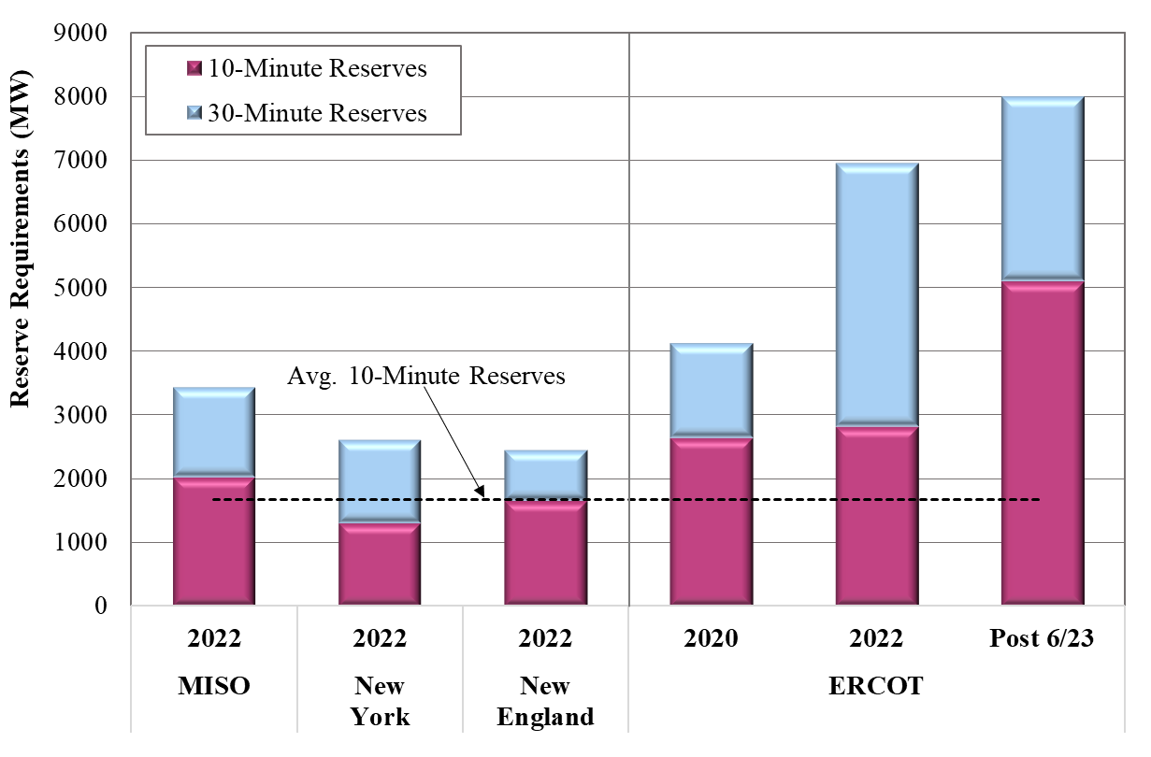
AS Procurements ERCOT vs. Other Markets

Slide 6
Determining the Value of Operating Reserve Requirement Levels
The AS methodology should be based on quantifiable reliability risks.
Reliability risks are caused by system contingencies and other uncertainties.
Reliability risk can be measured by a “loss of load probability” that is produced by stochastic modeling of contingencies and uncertainties.
Reasonable AS requirements must be based on:
Reducing the loss of load probability; and
The value of this reduction is based on the value of lost load.
The next figure shows such a curve that we estimated for MISO’s 10-minute reserves – it is based on a VOLL = $25,000 per MWh.
It shows that the marginal value of the operating reserves falls as the quantity of reserves held increases.
MISO requirements is set at a point where the reserves have a value of roughly $500/MWh.

Slide 7
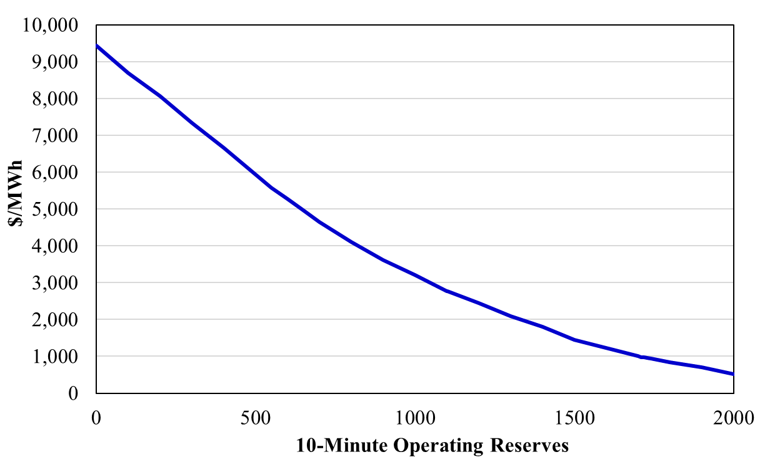
The Reliability Value of 10-Minute Reserves

Slide 8
Establishing Reliability-Based ECRS Requirements
ERCOT’s AS methodology proposes that multiple classes of reserves be based historical average quantities (e.g., net load forecast errors).
This is not consistent with a probabilistic quantification of the reliability risks the reserves are intended to address.
We used ERCOT data to quantify the LOLP and value of ECRS based on the probability of forced outages for all of ERCOT’s generators, as well as load and intermittent generation forecast errors.
The next figure shows the marginal LOLP with no ECRS purchased and with the full ECRS procurement, as well as the total value of the reduction in LOLP assuming a VOLL of $20,000 per MW:
There were no material risks of load shedding this summer, despite the hot weather and high load.
Modest amounts of ECRS address loss of load probabilities generally ranging from 0 to 0.2%, producing values averaging $16/MWh.
The marginal value of the full ECRS procurement is close to zero.

Slide 9
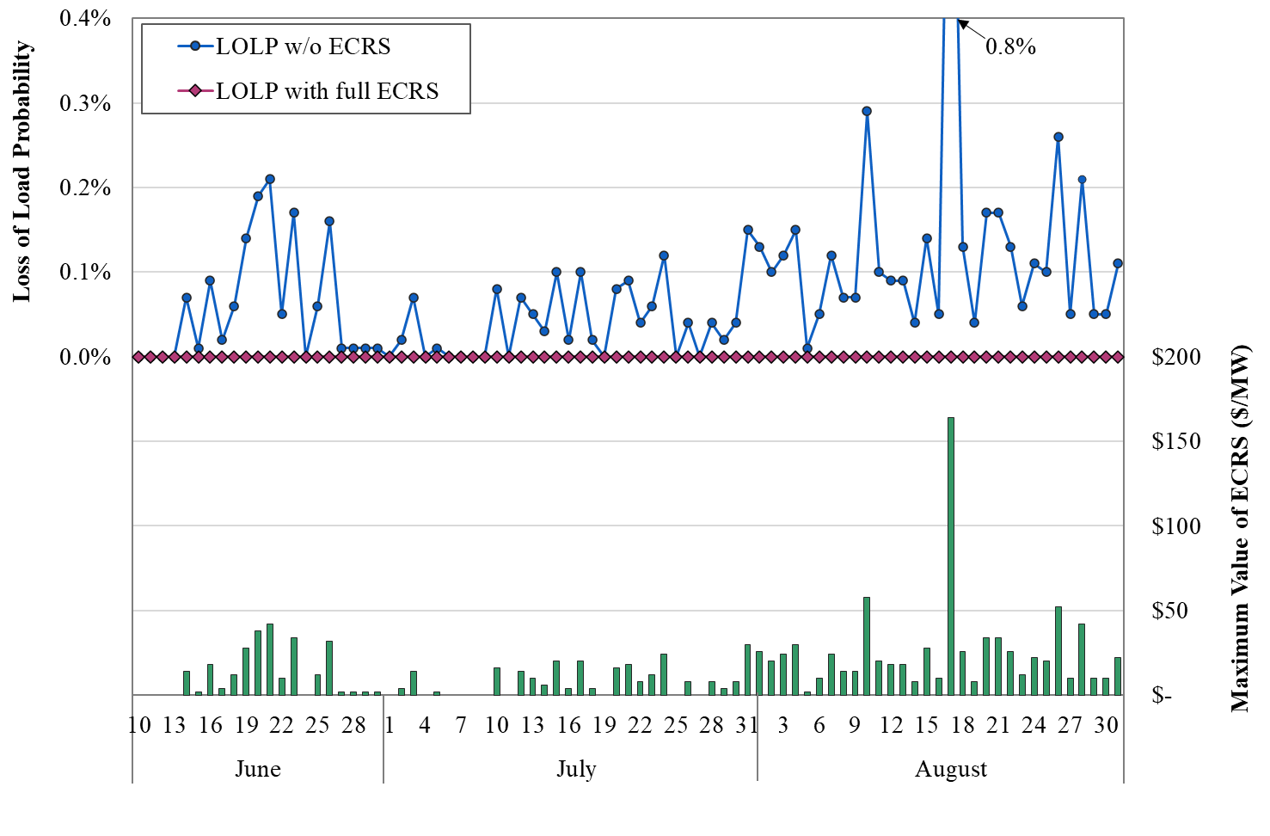
The Reliability Value of 10-Minute Reserves

Slide 10
Estimating the Costs of Overprocurement
The prior analysis and the benchmarking of ERCOTs AS requirements to other RTOs suggests that ERCOT’s requirements are excessive.
Because the 10-minute reserves (RRS and ECRS) are withheld from the market, they can:
Tighten the supply margin in the market; and
Raise prices and generate associated market costs.
We estimated these effects by simulating the market prices and costs of making most of the withheld ECRS available to the market.
The next figure shows these simulated results of the sharp rise in 10-minute reserve requirements occurring when ECRS was implemented.
The monthly average prices during this period rose 8 to 140 percent.
The cumulative market costs of these increases exceeded $12.5 Billion.
Contracts/hedges prevent these costs from being borne immediately by retail customers – but they will bear them in the long-run as forward prices have risen by comparable amounts.

Slide 11
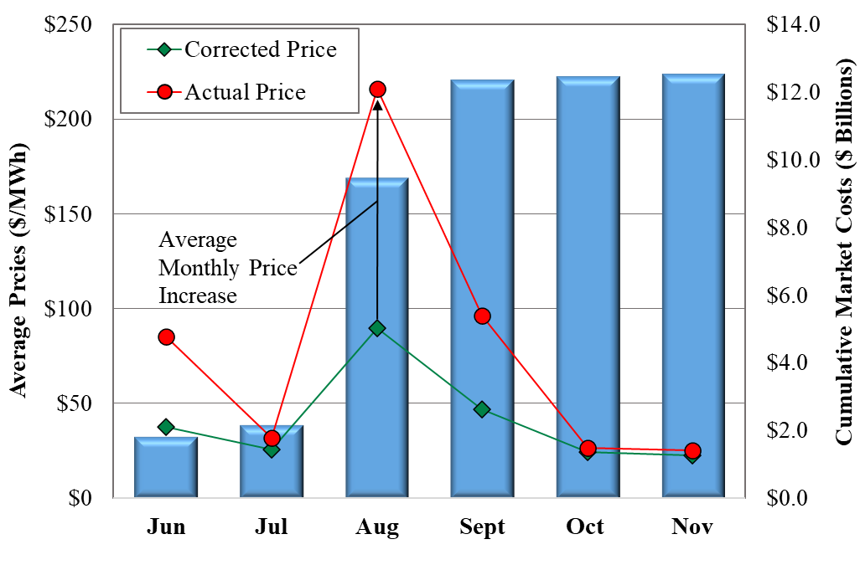
Simulated Energy Cost Increases from Higher Online Reserve Procurements: June 10 – Nov. 27, 2023

Slide 12
AS Methodology Recommendations
We recommend that TAC not approve the proposed AS methodology.
ERCOT should quantify the reliability risks to be addressed by the AS procurements by employing a stochastic reliability model.
This should address concerns that non-spin, ECRS and RRS address overlapping frequency response, contingency and forecast error issues.
Our concerns with the 2024 methodology can be mitigated by:
Further reduce the frequency recovery MW procurement for ECRS.
Change the non-spin 6-hour ahead error requirement to 2-hour ahead.
Use 10-minute ahead net load errors for ECRS methodology, which is much more consistent with the actual use of the product.
Reduce ECRS duration requirement back to one hour – requiring that resources providing ECRS be able to deploy for at least two hours effectively reduced energy storage resource participation by half.

