Slide 1
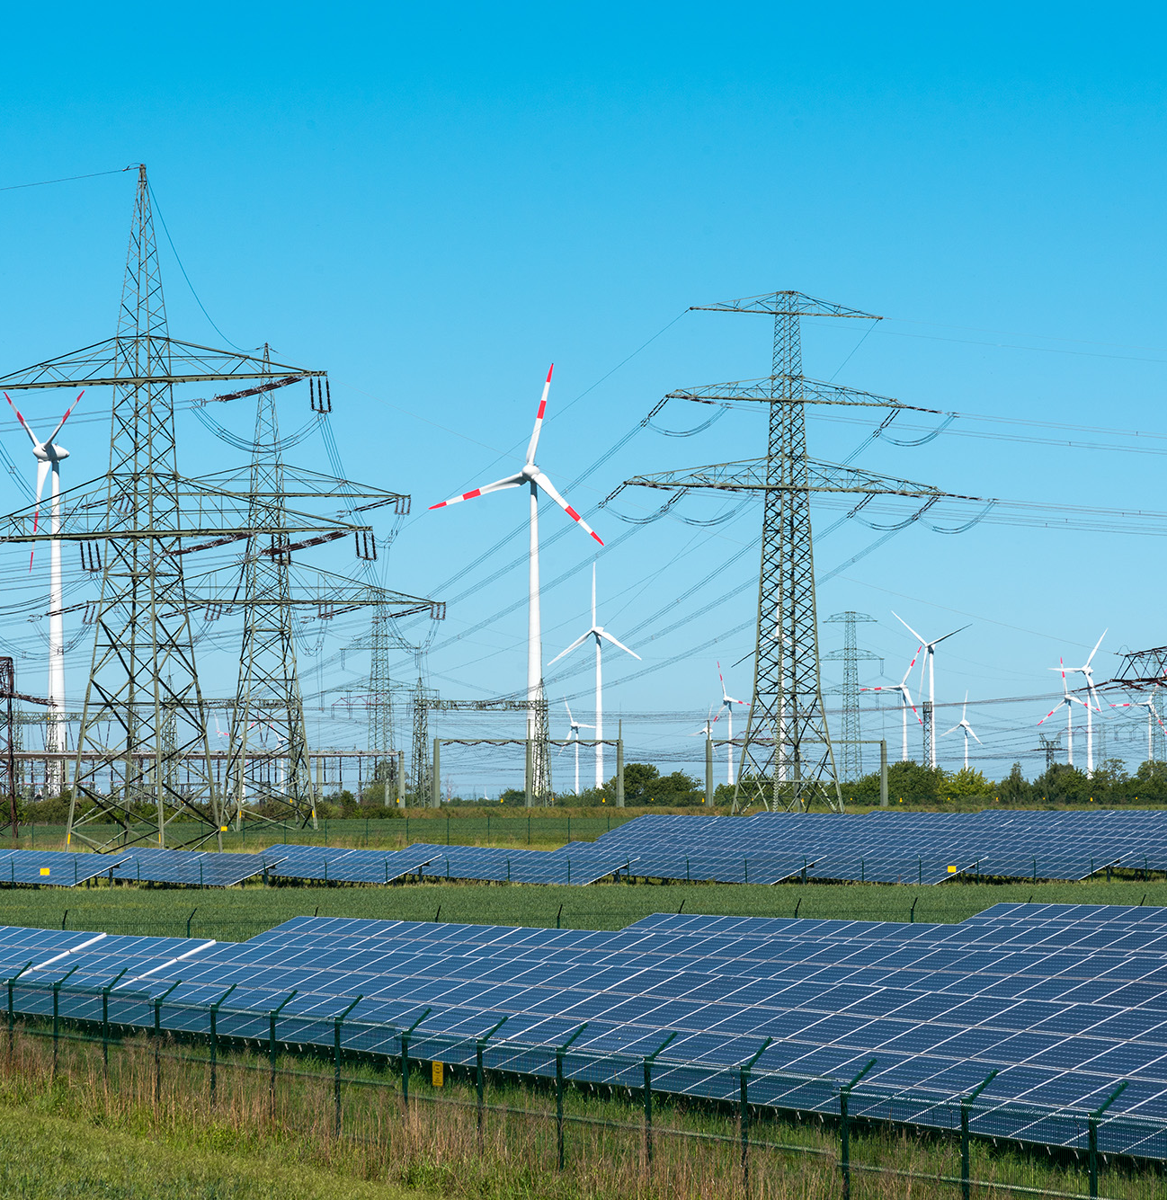
NV Energy Day-Ahead Market Benefits Studies
Comparative benefits for NV Energy of joining EDAM vs Markets+
Presented by
John Tsoukalis
Kai van horn
Linquan Bai
Evan bennett
Sophie Edelman
Ellery curtis
Presented for
NV Energy
February 2024

Slide 2
Overview of NVE Market Benefits Studies

Slide 3
Timeline of NVE Market Benefits Studies
Overview of NVE Studies
Brattle was engaged by NV Energy (NVE) through the second half of 2023 and into early 2024 to conduct a series of EDAM and Markets+ (M+) participation benefits studies
1
Summer 2023
2
Fall 2023
3
January 2024
  EDAM Benefits Study
  Expanded the modeling conducted for the Balancing Authority of Northern California (BANC), Idaho Power (IPCO), Los Angeles Dept. of Water and Power (LADWP), PacifiCorp (PAC), and the Sacramento Municipal Utility District (SMUD) to include NVE.
  We studied two cases:
  (1) A business as usual (BAU) case, maintain the existing WEIM and existing bilateral market
  (2) An EDAM case with a market footprint including NVE, BANC, CAISO, IPCO, LADWP, PacifiCorp, and Portland General Electric (PGE).
  M+ Benefits Study
  As the M+ design developed, we studied the benefits of joining M+ based on the proposed design as of October 2023.
  We studied two additional cases:
  (1) A BAU case with a small EDAM footprint (CAISO, PAC, LDWP, BANC), the WEIM with all current participants, and the SPP RTO West/Western Energy Imbalance Service (WEIS)
  (2) An M+ case in which all non-EDAM participants in the U.S. WECC (except IID and TIDC) plus PowerEx join M+ (with a day-ahead and real-time M+ market)
  EDAM/M+ Footprint Scenarios
  We analyzed the customer benefits for NVE under a range of EDAM and M+ market participation scenarios
  We studied six additional cases:
  A BAU case, with bilateral markets & WEIM
  A Bookend EDAM case, in which most of the WECC joined EDAM
  A Bookend Markets+ case, in which most of the WECC not committed to EDAM joined Markets+
  - (6) three cases of varying EDAM/M+ footprints including different market participation for NVE
Estimated NVE market participation benefits ($million per year)
(1) EDAM and (2) M+ study benefits fall in range of (3) Footprint Scenario benefits
EDAM | $113 | -- | $62 to $149
M+ | -- | $5 | -$17 to $16

Slide 4
Scope of Studies
Overview of NVE Studies
Scope: to simulate the specific EDAM/M+ designs for realistic market footprints, not a simplified representation of a wholesale market across the entire WECC
  Calculate a multiple benefit metrics: (1) Adjusted Production Cost (APC), (2) impact on wheeling revenue, (3) loss of bilateral trading profits, and (4) EDAM/M+ congestion and transfer revenues
  Model the EDAM and/or M+ GHG structure: as specified in the design or contemplated design
    EDAM: simulated the “GHG Reference Pass” to set limits on transfers into the GHG region (CA and WA).
    M+: simulated “Resource Owner, Merit Order w/ Enhanced Floating Surplus” approach to setting transfer limits into GHG regions
    Modeled resource-type-specific GHG costs
  Simulate existing & prospective real-time markets: WEIM in parallel with the EDAM, formation of a day-ahead and real-time market with M+, nodal representation of entire WECC
    Estimated the impact on existing WEIM and new EDAM or Markets+ trades and congestion revenues
  Capture value of coupled day-ahead and real-time markets to manage unexpected imbalance: modeled renewable and load forecast uncertainty between DA and RT
  Realistically represent bilateral markets: captured existing contract-path transmission rights, major trading hubs, block trading, CAISO intertie trades, hourly BA-to-BA trades, and wheeling charges where applicable

Slide 5
Key Model Features
Overview of NVE Studies
We conducted all study simulations using a nodal production cost model of the WECC with added market functionality, such as contract-path transmission.
  Model developed in PSO/Enelytix, which contains state-of-the-art features
    Simultaneously optimizes contract path and physical constraints
    Models bilateral, day-ahead, and real-time markets sequentially through multiple solution cycles
    Co-optimizes storage resources with other resources in unit-commitment and dispatch
    Detailed ancillary service and operating reserve modeling and co-optimization of ancillary services with energy
  The study year is 2032, which aims to reflect the first decade of markets operations, representing both an intermediate year in the near-future and a year with reasonably high renewable penetration in the WECC
  Model includes two extreme weather events based on a historic cold snap and a historic heat wave
    These events are modeled as single weeks in which we increase modeled loads (peak and energy) and gas prices beyond the typical weather-normalized values to reflect the increased strain on the system and the ramifications of markets for addressing such strain.
    Capturing non-weather-normal impacts is becoming increasingly important due to the increasing frequency of severe weather events
  Modeled hydro represents average hydro year in the WECC, using data from 2009 for hydro generation
  Study base cases include the existing WEIM and WEIS markets, meaning all noted cost and benefit metrics already include an entity’s benefit coming from WEIM and WEIS (and thus all results show incremental loss or gain in WEIM and WEIS benefits as a day-ahead market is formed)
  See Appendix for additional model and assumptions detail, including detail related to EDAM and M+ design modeling

Slide 6
Estimated EDAM & M+ Benefits are Conservatively Low
Overview of NVE Studies
The estimated benefits are likely understated due to several factors:
  Overstated base-case efficiency: our simulation of the BAU is more efficient than reality
    The Base Case assumes that balancing authorities have optimal security-constrained unit-commitment and dispatch (SCUC and SCED) in both DA and RT, making the simulated dispatch more optimal than in reality.
    Inefficient utilization of transmission by bilateral trades is not fully modeled, understating the extent EDAM and M+ will be able to make better use of all physically and contractually available transmission.
    Transmission outages are not modeled, which would magnify the benefit of SCED-based congestion management in EDAM and M+ compared to the BAU
  Normalized loads and fuel prices: the model uses weather-normalized loads and averaged monthly natural gas prices without daily volatility
    Challenging market conditions (beyond the included heat wave and cold snap), such during as the 2022 gas price spikes, will magnify EDAM/M+ benefits. Illustrated by the WEIM experience of much higher benefits in 3Q of 2021 and 3Q-4Q of 2022
    The Base Case does not reflect the limited liquidity of bilateral market during challenging market conditions
  No capacity benefits quantified: we have not quantified the extent to which EDAM and M+ may reduce investment costs associated with lower operating reserve requirements

Slide 7
Summer 2023 NVE EDAM benefits study
Overview of NVE studies
Overview of Study Setup
Summary of NVE EDAM Participation Benefit Drivers
$million, EDAM minus BAU cases
1
2022 EDAM Benefits Study model
BAU & EDAM scenarios
Increased EDAM to Southwest exports via NVE increase NVE wheeling revenues and generate EDAM transfer revenues
Updates & Enhancements:
NVE resource mix, load, and transmission updates
Other joint study funder resource mix, load, and transmission updates
Add NVE to EDAM footprint
Updated CAISO/PAC resource mix & load to latest IRPs
Add Trans West Express
$113 million
cost decrease or
revenue increase
Increased sales of efficient gas generation increase production costs but generates significant sales revenue, a net APC benefit for NVE
2
cost increase or
revenue decrease
3
NVE EDAM Benefits Study model
BAU & EDAM scenarios
DA Market Congestion Revenue
RT Market Congestion Revenue
Bilateral Trading Revenue
Wheeling Revenue
Sales Revenue
Purchase Cost
Production Cost
Net Benefit (dash)

Slide 8
Fall 2023 NVE Markets+ benefits study
Overview of NVE Studies
Overview of Study Setup
Summary of NVE M+ Participation Benefit Drivers
$million, M+ minus BAU cases
1
NVE EDAM Benefits Study model
BAU & EDAM scenarios
Decrease in gas generation, especially in real time, decreases production costs, but also reduces sales revenue and increases purchase costs
cost decrease or
revenue increase
Updates & Enhancements:
Added M+ footprint
Added SPP West RTO and WEIS footprints
Reduced WEIM footprint (shifts to M+)
Expanded DA/RT forecast uncertainty modeling to all US WECC BAs (previously just study participants)
$5 million
2
Leaving WEIM and decreased bilateral trading due to multiple market footprints results in significant lost trading revenue, only partially offset by M+ transfer revenues
cost increase or
revenue decrease
3
NVE M+ Benefits Study model
BAU & M+ scenarios
DA Market Congestion Revenue
RT Market Congestion Revenue
Bilateral Trading Revenue
Wheeling Revenue
Sales Revenue
Purchase Cost
Production Cost
Net Benefit (dash)

Slide 9
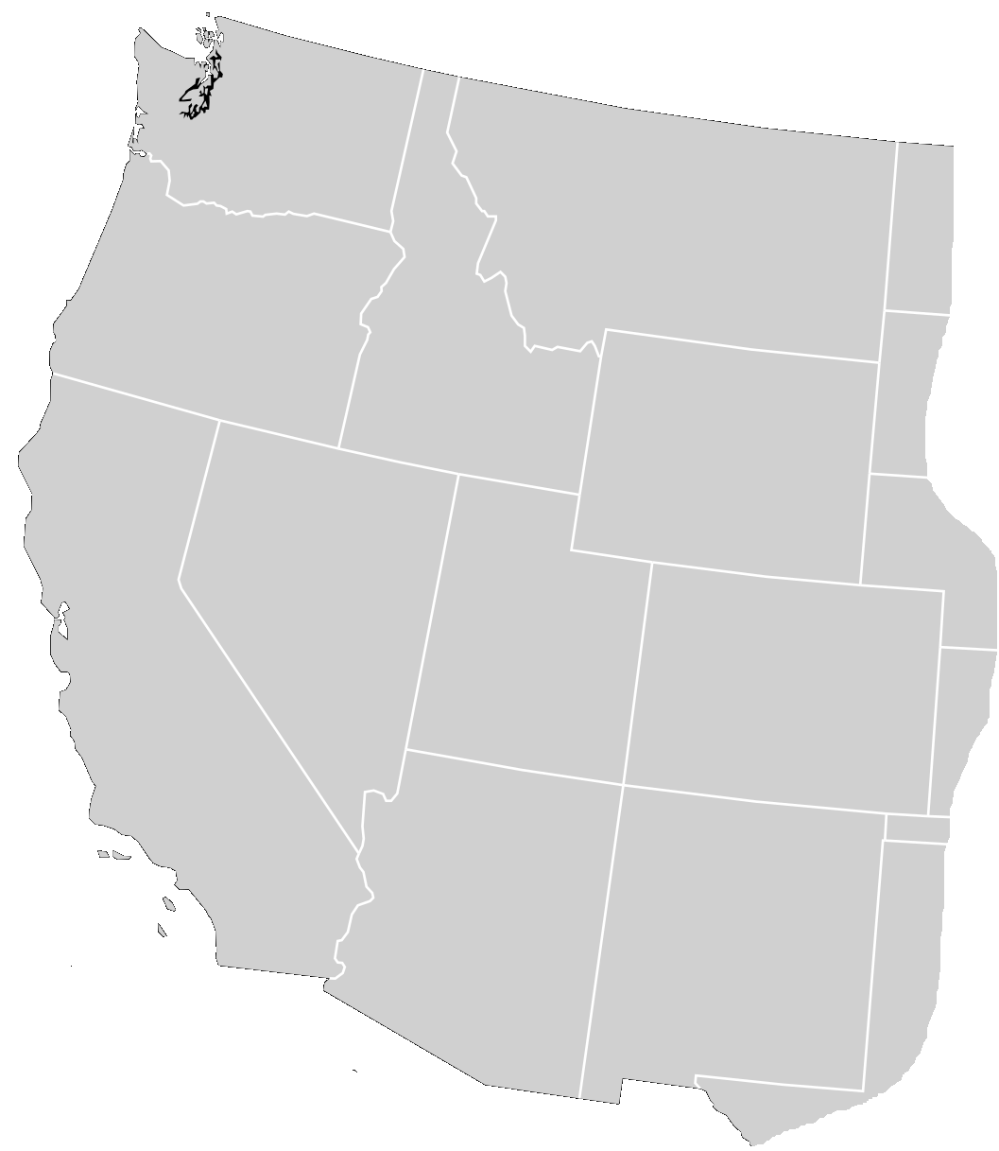
January 2024 EDAM/M+ Footprint Scenarios
Overview of NVE Studies
BAU
BCHA/
Powerex
AESO
PSEI
CHPD
AVA
SCL
DOPD
GCPD
NWMT
WAPA Upper Great Plains
BPA
Footprint scenarios designed to capture realistic range of potential future market footprints
  M+ assumed to have day-ahead and real-time markets
  RTO West co-optimized with M+ where applicable
TPWR
SPP RTO West
PGE
WAPA CO/MO
PacifiCorp West
Idaho Power
WEIS only
PacifiCorp East
Markets+
CAISO
NV Energy
SMUD
Public Serv. CO
EDAM & WEIM
BANC
TIDC
WAPA Lower CO
WEIM only
SRP
PNM
LDWP
AZPS
Non-Market BA
IID
CFE
TEPC
EPE
Bookend EDAM
Middle View 1
Middle View 2
Middle View 3
Bookend M+
BCHA/
Powerex
AESO
BCHA/
Powerex
AESO
BCHA/
Powerex
AESO
BCHA/
Powerex
AESO
BCHA/
Powerex
AESO
PSEI
CHPD
AVA
PSEI
CHPD
AVA
PSEI
CHPD
AVA
PSEI
CHPD
AVA
PSEI
CHPD
AVA
SCL
DOPD
GCPD
NWMT
WAPA Upper Great Plains
SCL
DOPD
GCPD
NWMT
WAPA Upper Great Plains
SCL
DOPD
GCPD
NWMT
WAPA Upper Great Plains
SCL
DOPD
GCPD
NWMT
WAPA Upper Great Plains
SCL
DOPD
GCPD
NWMT
WAPA Upper Great Plains
BPA
BPA
BPA
BPA
BPA
TPWR
TPWR
TPWR
TPWR
TPWR
PGE
WAPA CO/MO
PGE
WAPA CO/MO
PGE
WAPA CO/MO
PGE
WAPA CO/MO
PGE
WAPA CO/MO
PacifiCorp West
Idaho Power
PacifiCorp West
Idaho Power
PacifiCorp West
Idaho Power
PacifiCorp West
Idaho Power
PacifiCorp West
Idaho Power
PacifiCorp East
PacifiCorp East
PacifiCorp East
PacifiCorp East
PacifiCorp East
CAISO
NV Energy
CAISO
NV Energy
CAISO
NV Energy
CAISO
NV Energy
CAISO
NV Energy
SMUD
Public Serv. CO
SMUD
Public Serv. CO
SMUD
Public Serv. CO
SMUD
Public Serv. CO
SMUD
Public Serv. CO
BANC
BANC
BANC
BANC
BANC
TIDC
WAPA Lower CO
TIDC
WAPA Lower CO
TIDC
WAPA Lower CO
TIDC
WAPA Lower CO
TIDC
WAPA Lower CO
SRP
PNM
SRP
PNM
SRP
PNM
SRP
PNM
SRP
PNM
LDWP
AZPS
LDWP
AZPS
LDWP
AZPS
LDWP
AZPS
LDWP
AZPS
CFE
IID
TEPC
EPE
CFE
IID
TEPC
EPE
CFE
IID
TEPC
EPE
CFE
IID
TEPC
EPE
CFE
IID
TEPC
EPE
NVE in EDAM
NVE in EDAM
NVE in M+
NVE in M+
NVE in M+
Bigger EDAM Footprint
Bigger M+ Footprint

Slide 10
January 2024 EDAM/M+ footprint scenario study benefits
Overview of NVE Studies
Overview of Study Setup
Summary of NVE EDAM/M+ Participation Benefit Drivers
$million, Footprint Scenario minus BAU case
1
NVE M+ Benefits Study model
BAU & M+ scenarios
DA Market Congestion Revenue
RT Market Congestion Revenue
Bilateral Trading Revenue
Wheeling Revenue
Sales Revenue
Purchase Cost
Production Cost
Net Benefit (dash)
$149 million
Updates & Enhancements:
Constructed alternative market footprints as directed by study funders
Added additional funder-specific resource mix, load, and transmission updates
Cases reflect the most up-to-date assumptions and modeling of the EDAM/M+ market designs
cost decrease or
revenue increase
$62 million
$16 million
2
$9 million
-$17 million
NVE shift out of EDAM & WEIM causes loss of RT market revenues and substantial increase in APC as NVE loses high-value sales opportunities
cost increase or
revenue decrease
Updated NVE Market Benefits Model
M+ & EDAM Footprint Scenarios
Bookend
EDAM
Middle
View 1
Middle
View 2
Middle
View 3
Bookend
Markets+
3
NVE in EDAM
NVE in Markets+
Benefits & drivers details provided in next section

Slide 11
NVE Markets+ / EDAM Footprint Scenarios Study Results

Slide 12
WECC-Wide Benefits
EDAM/Markets+ Footprint Scenarios
  The implementation of M+ and/or EDAM produces significant WECC-wide customer benefits, with benefits ranging from $682-$985 million per year across the footprint scenarios
  A single market covering most of the WECC (bookend EDAM in this case) produces the highest benefits
  A two-market EDAM/M+ scenario with little market transfer capability between the Pacific Northwest and the Southwest in the M+ footprint (Middle View 2) produces the lowest benefits
The Bookend EDAM produces the lowest WECC-wide APC, indicating the most efficient system dispatch
However, wheeling revenues, bilateral trading gains and market congestion may be higher in some split cases
All market participation scenarios show benefits relative to BAU

Slide 13
WECC-Wide Trading
EDAM/Markets+ Footprint Scenarios
Implementation of organized DA markets increases WECC-wide 20-30% (60-90 TWh)
  The Bookend EDAM case, in which most WECC entities are in the same market, produces the highest total trading volume of the modeled cases
  Markets+ trades decrease considerably as the footprint shrinks
    Removing AVA, NWMT, PNM, and EPE (Middle View 3) drops trading 26 TWh (18.5%) relative to Bookend Markets+
    Removing also IPCO (Middle View 2) drops trading a further 18 TWh (15.4%) relative to Middle View 3
    Removing also NVE, PGE, and SCL (Middle View 1) drops trading a further 27 TWh (28%) relative to Middle View 2
    Middle View 1 has just 50% the original Bookend Markets+ trading volume despite having 74% of the original load
Total WECC Trading by Case and Type
GWh
Note: Bookend EDAM bilateral trades are mostly with non-market BAs like BCHA and AESO, and the SPP West RTO, which imports solar generation from WALC and AZPS.

Slide 14
Nevada Benefits in the EDAM/M+ Footprint Scenarios
EDAM/Markets+ Footprint Scenarios
The footprint scenarios suggest NVE benefits are higher in EDAM than in Markets+
  EDAM benefits range from $62 million to $149 million
  Markets+ benefits range from a loss of $17 million to a benefit of $16 million

Slide 15
EDAM and M+ benefits drivers distinctive
EDAM/Markets+ Footprint Scenarios
EDAM sensitivity benefits driven mostly by additional sales revenue and trading benefits
  Higher sales value driven by both higher sales quantities and higher average sales prices
M+ sensitivity benefits driven almost exclusively by savings on reduced internal generation costs
  M+ transfer revenues also a source of benefits, but lost bilateral and WEIM revenues relative to BAU result in negative net trading revenue in M+
Case Benefit Compared to BAU
$ Millions
$149 million
cost decrease or
revenue increase
$62 million
$16 million
$9 million
-$17 million
cost increase or
revenue decrease
Bookend
EDAM
Middle
View 1
Middle
View 2
Middle
View 3
Bookend
Markets+
NVE in EDAM
NVE in Markets+

Slide 16
Bookend EDAM
EDAM/Markets+ Footprint Scenarios
Bookend EDAM vs. BAU
BCHA/
Powerex
AESO
  Bookend EDAM gives Nevada its highest trading volumes, but not highest benefits
  (1) NVE facilitates market trades between CA and the SW
    Nearly 9,000 GWh increase in trade between NVE<>SW and 10,500 GWh increase in trade between NVE<>CA
  (2) NVE enables greater transfer of low cost generation from CA and SW (solar and efficient gas) into IPCO and PACE
  APC savings and EDAM transfer revenues drive benefit of $62 million/yr
PSEI
CHPD
AVA
DOPD
WAPA Upper Great Plains
SCL
GCPD
NWMT
BPA
TPWR
PGE
Idaho Power
WAPA CO/MO
PacifiCorp West
(2) IPCO & PACE
+2,000 GWh exp
PacifiCorp East
CAISO
NV Energy
SMUD
Public Serv. CO
CAISO & LDWP
+10,500 GWh imp/exp
BANC
TIDC
WAPA Lower CO
SRP
PNM
AZPS
LDWP
(1) SRP & AZPS
+9,000 GWh imp/exp
CFE
IID
TEPC
EPE
SPP RTO West Member
Markets+ (DA and RT) Member
EDAM and WEIM Member
WEIM-Only Member

Slide 17
Middle View 1
EDAM/Markets+ Footprint Scenarios
Middle View 1 vs. Bookend EDAM
  Middle View 1 sees fewer NVE trades, but more access to low-cost purchases and higher benefits
  (1) CAISO transactions fall as opportunities to sell through NVE into the SW reduced with SRP & AZPS shifting into M+
    Some exchange with SW replaced by trading with IPCO/PACE
  (2) Less competition for in-footprint low-cost generation increases NVE imports from remaining EDAM footprint
  Higher trade value and lower APC drives benefits up to $149 million/yr
BCHA/
Powerex
AESO
PSEI
CHPD
AVA
DOPD
WAPA Upper Great Plains
SCL
GCPD
NWMT
BPA
TPWR
PGE
Idaho Power
WAPA CO/MO
PacifiCorp West
(2) IPCO & PACE
+3,000 GWh imp/exp
PacifiCorp East
CAISO
NV Energy
SMUD
CAISO
-6,000 GWh imp/exp
Public Serv. CO
BANC
TIDC
WAPA Lower CO
SRP
PNM
SRP & AZPS
-10,000 GWh imp/exp
AZPS
LDWP
CFE
IID
TEPC
EPE
SPP RTO West Member
Markets+ (DA and RT) Member
EDAM and WEIM Member
WEIM-Only Member

Slide 18
Generation Shifts in NVE – EDAM Cases
EDAM/Markets+ Footprint Scenarios
Bookend EDAM vs. BAU
  The scope of the EDAM footprint has significant impact on NVE generation
  In Bookend EDAM, NVE gas generation increase overnight to displace less efficient gas in the footprint, while modestly reducing gas generation midday to take advantage of cheap excess solar from CAISO and LDWP
  Smaller Middle View 1 EDAM footprint bottles up more midday solar resulting in more NVE purchase opportunities
    NVE reduces generation midday to capitalize on additional excess solar
    Increased oversupply in the EDAM footprint relative to Bookend EDAM case drives increase in NVE curtailments
Middle View 1 vs. Bookend EDAM

Slide 19
Middle View 1 and Bookend EDAM
EDAM/Markets+ Footprint Scenarios
MV1 shows the highest benefits for Nevada (higher even than Bookend EDAM) due increased availability of low-cost purchases
  This is driven by the specific footprint assumed for Middle View 1:
    MV1’s EDAM contains the largest solar, wind, and battery storage entities in the WECC, containing 46% of WECC load but 80% of solar generation, 70% of storage capacity, and 68% of wind generation
    In contrast Bookend EDAM contains 74% of WECC load, but 97% of solar generation, 97% of storage capacity, and 83% of wind generation
  This significant renewable excess in the MV1 EDAM footprint reduces Nevada’s purchase costs by ~$50 million relative to Bookend EDAM
NVE Weighted Cost of Purchases
Average by Hour of Day
MV1 has more periods of excess renewables creating
opportunities to purchase lower prices

Slide 20
Bookend Markets+
EDAM/Markets+ Footprint Scenarios
Bookend Markets+ vs. BAU
BCHA/
Powerex
AESO
  Bookend Markets+ sees big shifts in NVE trading patterns from BAU
  (1) Increased costs to access to low-cost gen in EDAM market (CAISO/PACE/LDWP) drives down trade volumes
  (2) NVE M+ trading increases with thermal heavy balancing authorities in the SW, and accesses PNW hydro via IPCO and BPA
  Significant APC reduction and M+ transfer revenue drive $17 million/yr in benefits
PSEI
CHPD
AVA
DOPD
WAPA Upper Great Plains
SCL
GCPD
NWMT
BPA
TPWR
(2) BPAT and IPCO
+2,500 GWh imp/exp
PGE
Idaho Power
WAPA CO/MO
PacifiCorp West
PacifiCorp East
CAISO
NV Energy
SMUD
CAISO/PACE/LDWP
-10,000 TWh imp/exp
Public Serv. CO
BANC
TIDC
WAPA Lower CO
SRP
PNM
AZPS
LDWP
(2) SRP/AZPS/WALC
+9,000 GWh imp/exp
CFE
IID
TEPC
EPE
SPP RTO West Member
Markets+ (DA and RT) Member
EDAM and WEIM Member
WEIM-Only Member

Slide 21
Middle View 3
EDAM/Markets+ Footprint Scenarios
Middle View 3 vs. Bookend Mkt+
BCHA/
Powerex
AESO
  Middle View 3 drops NWMT, EPE, PNM, AVA from Markets+, modestly reducing NVE benefits
  Overall NVE trading & generation remains similar to Bookend M+, but the reduced footprint modestly reduces NV sales revenue and increases purchase costs
  NVE benefit declines to $9 million/yr
    Decline driven by $2m in reduced Markets+ transfer revenues and $6m in higher APC
PSEI
CHPD
AVA
DOPD
WAPA Upper Great Plains
SCL
GCPD
NWMT
BPA
TPWR
PGE
Idaho Power
WAPA CO/MO
PacifiCorp West
PacifiCorp East
CAISO
NV Energy
SMUD
Public Serv. CO
BANC
TIDC
WAPA Lower CO
SRP
PNM
AZPS
LDWP
CFE
IID
TEPC
EPE
SPP RTO West Member
Markets+ (DA and RT) Member
EDAM and WEIM Member
WEIM-Only Member

Slide 22
Middle View 2
EDAM/Markets+ Footprint Scenarios
Middle View 2 vs. Middle View 3
BCHA/
Powerex
AESO
  Middle View 2 removes Idaho from Markets+, cutting off a major pathway between SW and PNW in M+
  NVE becomes the only link to the PNW, but only with 200 MW from SPPC to BPAT
    Flows with Idaho decline more than 3,000 GWh; trading with BPA already hitting limits during valuable periods in MV3, so changes little
  Small increase in APC and significantly reduced M+ transfer revenues drives NVE M+ benefits down to -$18 million
PSEI
CHPD
AVA
DOPD
WAPA Upper Great Plains
SCL
GCPD
NWMT
BPA
TPWR
PGE
Little SW<>PNW capacity remains in M+
WAPA CO/MO
PacifiCorp West
Idaho Power
PacifiCorp East
CAISO
NV Energy
SMUD
Public Serv. CO
BANC
TIDC
WAPA Lower CO
SRP
PNM
AZPS
LDWP
CFE
IID
TEPC
EPE
SPP RTO West Member
Markets+ (DA and RT) Member
EDAM and WEIM Member
WEIM-Only Member

Slide 23
NVE Generation Shifts – Markets+ Cases
EDAM/Markets+ Footprint Scenarios
  NVE gas generation shifts a driver of M+ benefits outcomes
  As M+ footprint scope declines, NVE produces less internally reducing sales revenue and increasing purchase costs
Bookend Mkt+ vs. BAU
Middle View 3 vs. Bookend Markets+
Middle View 2 vs. Middle View 3

Slide 24
NV System Benefits by Case
EDAM/Markets+ Footprint Scenarios
The table below shows the benefit (as opposed to total cost in the previous tables) by metric compared to the BAU case

Slide 25
NVE Benefits Study Takeaways
EDAM/Markets+ Footprint Scenarios
  The highest WECC-wide market benefits in these cases accrue to a single, nearly WECC-wide market, while the lowest WECC-wide benefits accrue to a split two-market scenario where the EDAM footprint divides a fragmented M+
  NVE estimated benefits are highest in the EDAM, largely due to the opportunity to sell additional generation at higher prices and buy at excess solar at lower prices
  NVE benefits significantly influenced by market footprint due to the its large amount of transfer capability and centrality in the WECC system
    NVE benefits tend to be higher when it is central to the market and facilitates transfers within the market (e.g., in Bookend M+ case, in which NVE facilitates transfers between the PNW and SW; or Bookend EDAM case, in which NVE facilitates transfers between CAISO and the SW)
    The opposite is also true: NVE benefits tend to be lower when it is on the margin of the market (e.g., in MV2, where it is largely disconnected from the PNW portion of the M+ footprint and on the edge of the SW portion of the M+ footprint)
  Shifting out of the WEIM when joining M+ has a major impact on NVE as it loses access to excess renewable supply from CAISO in real time, and sees lower prices for RT sales

Slide 26
Appendix: EDAM/M+ Footprint Scenario Market Footprint Assumptions

Slide 27
BAU Case
Appendix: EDAM/M+ Footprint Scenario Market Footprint Assumptions
BCHA/
Powerex
AESO
  For the BAU case, Brattle assumes the day-ahead market will remain bilateral, except for the formation of SPP RTO West
  WEIS entities (including SPP RTO West) in Yellow
    Assumes SPP West RTO includes WACM and WAUW by 2032
    Also assumes PSCO joins by 2032
  WEIM entities in teal
    Existing WEIM footprint modeled
PSEI
CHPD
AVA
DOPD
WAPA Upper Great Plains
SCL
GCPD
NWMT
BPA
TPWR
PGE
Idaho Power
WAPA CO/MO
PacifiCorp West
PacifiCorp East
CAISO
NV Energy
SMUD
Public Serv. CO
BANC
TIDC
WAPA Lower CO
SRP
PNM
AZPS
LDWP
CFE
IID
TEPC
EPE
SPP RTO West Member
WEIS Member
WEIM Member
Non-Market BA

Slide 28
Bookend EDAM
Appendix: EDAM/M+ Footprint Scenario Market Footprint Assumptions
BCHA/
Powerex
AESO
  Bookend EDAM assumes almost all WECC utilities join EDAM
  EDAM Entities in Blue
    EDAM entities assumed to also participate in the WEIM
    Powerex and TIDC assumed to remain in WEIM
  SPP West RTO continues to exist in the east
    PSCO remains in the WEIS
  IID, CFE, and AESO assumed to trade only bilaterally
PSEI
CHPD
AVA
DOPD
WAPA Upper Great Plains
SCL
GCPD
NWMT
BPA
TPWR
PGE
Idaho Power
WAPA CO/MO
PacifiCorp West
PacifiCorp East
CAISO
NV Energy
SMUD
Public Serv. CO
BANC
TIDC
WAPA Lower CO
SRP
PNM
AZPS
LDWP
CFE
IID
TEPC
EPE
SPP RTO West Member
Markets+ (DA and RT) Member
EDAM and WEIM Member
WEIM-Only Member
Non-Market BA

Slide 29
Middle View 1
Appendix: EDAM/M+ Footprint Scenario Market Footprint Assumptions
BCHA/
Powerex
AESO
  Middle View 1 assumes the entities that have announced they are joining EDAM go to EDAM, plus PGE, Idaho, Nevada, and SCL
  Markets+ Entities in Orange
    Includes all Phase 1 Funders of Markets+, less the entities assumed to be in EDAM in this case
    M+ entities assumed to also participate in SPP-run RT market, similar to WEIS
    The SPP West RTO cooptimizes with Markets+
  EDAM Entities in Blue
    EDAM entities assumed to also participate in the WEIM
    TIDC would remain in WEIM
  IID, CFE, and AESO assumed to trade only bilaterally
PSEI
CHPD
AVA
DOPD
WAPA Upper Great Plains
SCL
GCPD
NWMT
BPA
TPWR
PGE
Idaho Power
WAPA CO/MO
PacifiCorp West
PacifiCorp East
CAISO
NV Energy
SMUD
Public Serv. CO
BANC
TIDC
WAPA Lower CO
SRP
PNM
AZPS
LDWP
CFE
IID
TEPC
EPE
SPP RTO West Member
Markets+ (DA and RT) Member
EDAM and WEIM Member
WEIM-Only Member
Non-Market BA

Slide 30
Middle View 2
Appendix: EDAM/M+ Footprint Scenario Market Footprint Assumptions
BCHA/
Powerex
AESO
  Middle View 2 assumes NVE, SCL, and PGE go to Markets+, but Idaho remains in EDAM
  Markets+ Entities in Orange
    Includes all Phase 1 Funders of Markets+, less the entities assumed to be in EDAM in this case
    M+ entities assumed to also participate in SPP-run RT market, similar to WEIS
    The SPP West RTO cooptimizes with Markets+
  EDAM Entities in Blue
    TIDC would remain in WEIM
  IID, CFE, and AESO assumed to trade only bilaterally
PSEI
CHPD
AVA
DOPD
WAPA Upper Great Plains
SCL
GCPD
NWMT
BPA
TPWR
PGE
Idaho Power
WAPA CO/MO
PacifiCorp West
PacifiCorp East
CAISO
NV Energy
SMUD
Public Serv. CO
BANC
TIDC
WAPA Lower CO
SRP
PNM
AZPS
LDWP
CFE
IID
TEPC
EPE
SPP RTO West Member
Markets+ (DA and RT) Member
EDAM and WEIM Member
WEIM-Only Member
Non-Market BA

Slide 31
Middle View 3
Appendix: EDAM/M+ Footprint Scenario Market Footprint Assumptions
BCHA/
Powerex
AESO
  Middle View 3 assumes Idaho joins Markets+ with NVE, SCL, and PGE
  Markets+ Entities in Orange
    M+ entities assumed to also participate in SPP-run RT market, similar to WEIS
    The SPP West RTO cooptimizes with Markets+
  EDAM Entities in Blue
    EDAM entities assumed to also participate in WEIM
    TIDC would remain in WEIM
  IID, CFE, and AESO assumed to trade only bilaterally
PSEI
CHPD
AVA
DOPD
WAPA Upper Great Plains
SCL
GCPD
NWMT
BPA
TPWR
PGE
Idaho Power
WAPA CO/MO
PacifiCorp West
PacifiCorp East
CAISO
NV Energy
SMUD
Public Serv. CO
BANC
TIDC
WAPA Lower CO
SRP
PNM
AZPS
LDWP
CFE
IID
TEPC
EPE
SPP RTO West Member
Markets+ (DA and RT) Member
EDAM and WEIM Member
WEIM-Only Member
Non-Market BA

Slide 32
Bookend Markets+
Appendix: EDAM/M+ Footprint Scenario Market Footprint Assumptions
BCHA/
Powerex
AESO
  Bookend Markets+ assumes almost all WECC utilities not committed to EDAM join M+
  Markets+ Entities in Orange
    M+ entities assumed to also participate in SPP-run RT market, similar to WEIS
    The SPP West RTO cooptimizes with Markets+
  EDAM Entities in Blue
    TIDC would remain in WEIM
  IID, CFE, and AESO assumed to trade only bilaterally
PSEI
CHPD
AVA
DOPD
WAPA Upper Great Plains
SCL
GCPD
NWMT
BPA
TPWR
PGE
Idaho Power
WAPA CO/MO
PacifiCorp West
PacifiCorp East
CAISO
NV Energy
SMUD
Public Serv. CO
BANC
TIDC
WAPA Lower CO
SRP
PNM
AZPS
LDWP
CFE
IID
TEPC
EPE
SPP RTO West Member
Markets+ (DA and RT) Member
EDAM and WEIM Member
WEIM-Only Member
Non-Market BA

Slide 33
Appendix: EDAM/M+ Footprint Scenario Trading Detail

Slide 34
NVE Trading Volumes
Appendix: EDAM/M+ Footprint Scenario Trading Detail

Slide 35
NVE Total Trading Value
Appendix: EDAM/M+ Footprint Scenario Trading Detail

Slide 36
NVE Average Trading Value
Appendix: EDAM/M+ Footprint Scenario Trading Detail
Note: calculated as the total trade value divided by total trade volume

Slide 37
Appendix: EDAM/M+ Footprint Scenario Adjusted Production Cost Details

Slide 38
Bookend EDAM
Appendix: EDAM/M+ Footprint Scenario apc detail
  Bookend EDAM has a $65.4 million adjusted production cost benefit for NVE

Slide 39
Middle View 1
Appendix: EDAM/M+ Footprint Scenario apc detail
  Middle View 1 has a $128.5 million adjusted production cost benefit for NVE

Slide 40
Middle View 2
Appendix: EDAM/M+ Footprint Scenario apc detail
  Middle View 2 has a $60.1 million adjusted production cost benefit for NVE

Slide 41
Middle View 3
Appendix: EDAM/M+ Footprint Scenario apc detail
  Middle View 3 has a $64.7 million adjusted production cost benefit for NVE

Slide 42
Bookend Markets+
Appendix: EDAM/M+ Footprint Scenario apc detail
  Bookend Markets+ has a $70 million adjusted production cost benefit for NVE

Slide 43
Appendix: Benefits Metrics

Slide 44
Benefit Metric: Adjusted Production Cost
Appendix: Benefits Metrics
Adjusted Production Cost (APC) is a standard metric used to capture the direct variable energy-related costs from a customer impact perspective
The APC is calculated for the BAU Case and the RTO case to determine the RTO-related reduction in APC
  By using the generation price of the exporter and load price of the importer for sales revenues and purchase costs, the APC metric does not capture wheeling revenues and the remaining portion of the value of the trade to the counterparties (see next slide)
  The APC is the sum of production costs and purchased power less off-system sales revenue:
  (+) Production costs (fuel, startup, variable O&M, emissions costs) for generation owned or contracted by the load-serving entities
  (+) Cost of bilateral and market purchases valued at the BAA’s load-weighted energy price (“Load LMP”)
  (−) Revenues from bilateral and market sales valued at the BAA’s generation-weighted energy price (“Gen LMP”)

Slide 45
Operational Benefit Metrics: Wheeling Revenues, Trading Gains
Appendix: Benefits Metrics
Based on the simulation results, we also estimate several additional impacts from increased trading facilitated by the market reforms, which is not fully captured in APC.
  Wheeling Revenues: collected by the exporting BAAs based on OATT rates
  Trading Gains: buyer and seller split 50/50 the trading margin (and congestion revenues in EIM/EDAM)
  EXAMPLE: Bilateral Trade
The APC metric only uses area-internal prices for purchase cost and sales revenues, which does not capture part of the value:
  A receives $30×50MWh=$1,500 in APC sales revenues
  B pays $50×50MWh=$2,500 in APC purchase costs
  ➔ $1,000 of trading value not captured in APC metric
Trading value = $20/MWh Δprice x 50 MWh = $1000
  Exporter A receives wheeling revenues: $8/MWh x 50MWh = $400
  Remaining $600 trading gain split 50/50: both A and B receive $300
A sells
50 MWh to B
A
Internal
Gen Price
$30/MWh
B
Internal
Load Price
$50/MWh
$8/MWh
Wheeling Charge

Slide 46
Illustration of EDAM Congestion and Transfer Revenues
Appendix: Benefits Metrics
EDAM congestion and transfer revenues estimated based on individual tieline LMPs:
Congestion Payment (to exporter) = MW x (Tie LMP₁ – Gen LMP₁)
Congestion Payment (to importer) = MW x (Load LMP₂ – Tie LMP₂)
Transfer Payment (split 50/50) = MW x (Tie LMP₂ – Tie LMP₁)
Tieline LMP₂-LMP₁
Transfer payments
Load LMP = Purchase cost to serve load
Load LMP
Congestion
Congestion
Gen LMP = Sales revenue to BA generators
Gen LMP
Avg. Gen Cost
Avg. Gen Cost = fuel + variable O&M
BA1
(exporter)
BA2
(importer)

Slide 47
Illustration of M+ Congestion/Transfer Revenues
Appendix: Benefits Metrics
M+ congestion/transfer revenues rolled together and estimated based on BA load and gen LMPs:
Congestion/Transfer Revenue Payment (split 50/50) = MW x (Load LMP₂ – Gen LMP₁)
Load LMP = Purchase cost to serve load
Load LMP
Congestion/Transfer
Gen LMP = Sales revenue to BA generators
Gen LMP
Avg. Gen Cost
Avg. Gen Cost = fuel + variable O&M
BA1
(exporter)
BA2
(importer)

Slide 48
Appendix: Additional Model Details

Slide 49

Overview of Modeling Approach
Appendix: additional model details
We utilize the WECC ADS nodal production cost model as a starting point imported into Power System Optimizer (PSO), as refined during the EDAM feasibility study and follow-on engagements
Utilized the Polaris Power System Optimizer (PSO), an advanced market simulation model
  Nodal mixed-integer model representing each load and generator bus in the WECC
  Licensed through Enelytix
  Detailed operating reserve and ancillary service product definition
  Detailed representation of the transmission system (both physical power flows and contract paths)
  Sub-hourly granularity (but used hourly simulations due to limited data availability)
  Designed for multiple commitment and dispatch cycles (e.g., DA and RT) with different levels of foresight
  EDAM feasibility study assumptions updated to reflect the most recent utility resource plans and forecasts of system conditions and costs
PSO is uniquely suited to simulate bilateral trading, joint dispatch, imbalance markets, and RTOs, reflecting multiple stages of system operator decision making

Slide 50
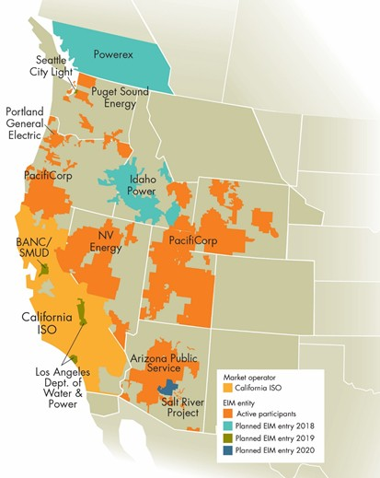
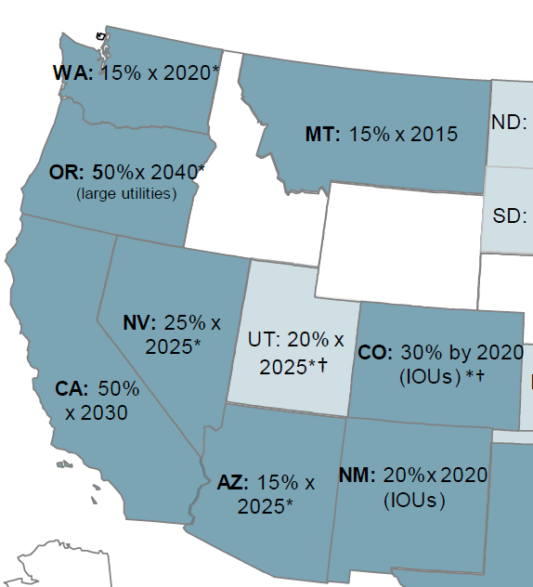
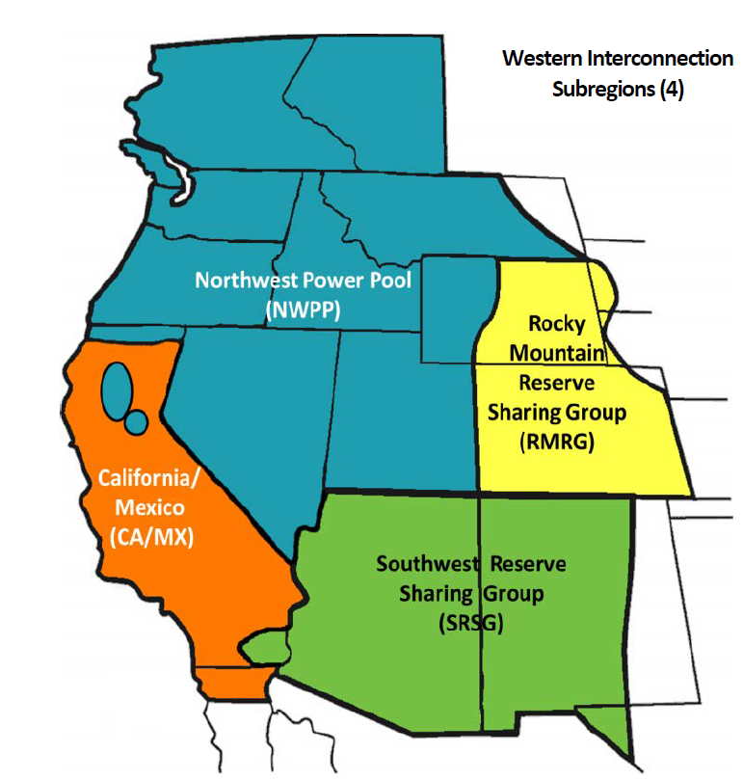
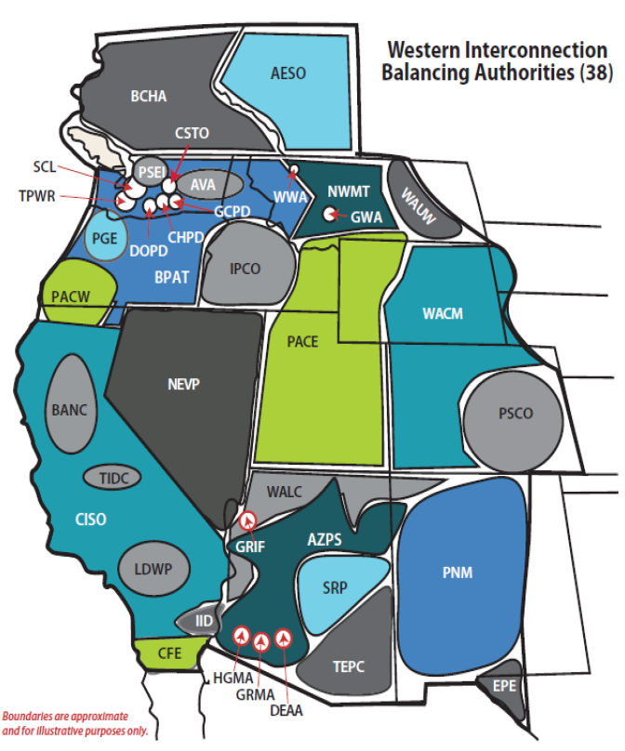
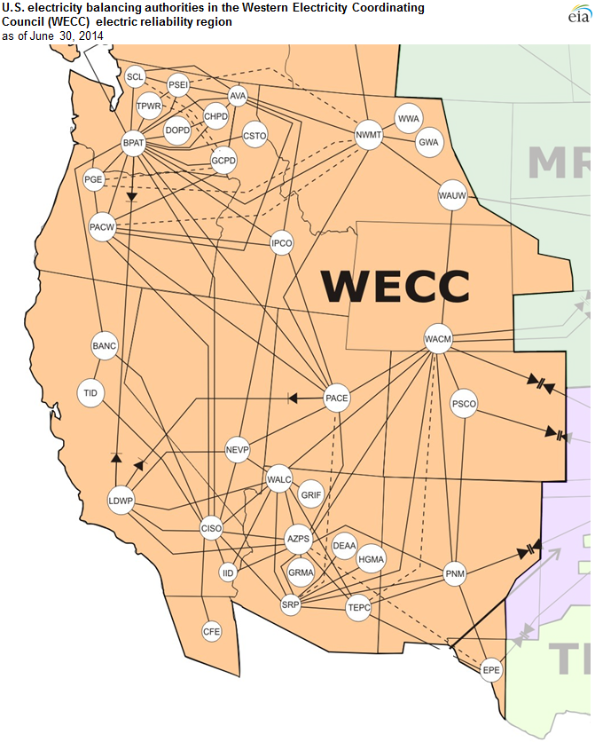
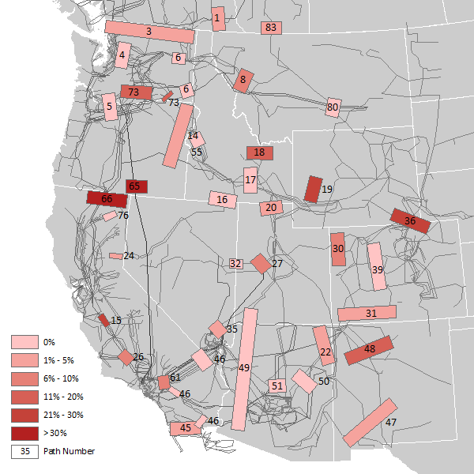
Multi-Functional Simulation of WECC
Appendix: additional model details
Markets/RTO
Functions &
Configurations
We employ a multi-layer simulations to represent the various physical, policy, and operational facets of the WECC
Clean Energy
Policies
Non-Market
Areas
  Physical grid with ~20k buses, ~25k lines and ~5k generators represented as DC power flow
  38 Balancing Authority Areas (BAAs) and contract paths
  The WECC reserve sharing groups
  Diverse state clean energy policies
  Major trading hubs (e.g., Mid-C, Malin, PV)
  Bilateral transmission rights
  Renewable diversity, day-ahead forecast uncertainty, real-time operations
  CAISO, RTO West, M+, EDAM, WEIM, & WEIS footprints
Carbon
Pricing
Reserve
Sharing
BAA
Functions
Bilateral
Contract
Paths and Transmission Rights
Physical
Flows and
Constraints

Slide 51
Independent Simulation of Multiple Time Horizons
Appendix: additional model details
We simulate multiple independent decision cycles to capture day-ahead vs. real-time unit commitment and dispatch and uncertainty
D-1 (am)
D-1 (~noon)
D-1 (pm-D)
D
DA Bilateral
Markets
Day-Ahead Market
Intra-Day Markets
EIM
(RT Balancing)
  DA block trades on long-term transmission rights and incremental transmission
Independent real-time decision cycle used to simulate EIM functions
  CAISO, EDAM, and RTO market clearing
  Hourly intertie trading
  Hourly trading with long-term transmission rights
  Hourly bilateral trades on remaining transmission
  EIM/CAISO trading of economic energy
  Transmission released for EIM
  RT balancing in BAAs
DA Unit Commitment Cycle
DA Economic Dispatch Cycle
Real Time Cycle
Decision cycles capture bilateral trading, market clearing, BAA functions in DA and RT, and market cycles
(incl. EDAM “GHG reference” pass, EDAM market, and EIM)
Independent real-time decision cycle used to simulate DA vs. RT, including forecast errors for wind and solar

Slide 52
Types of Trades and Transmission Reservations Modelled
Appendix: additional model details
Types of Trades Modeled
Our model simulates the use of different types of contract-path transmission reservations for bilateral trading across DA and RT
Existing long-term transmission contracts (ETCs) and incrementally purchased transmission
Total reservations on each contract path is limited by the total transfer capability (TTC)
Trades are structured as blocks or hourly
Bilateral trades between BAs, at major hubs, or across CAISO or RTO West interties
Account for renewable diversity and day-ahead forecast uncertainty vs. real-time operations
Unscheduled transfer capability released for EIM trades in real-time
Total Transmission Capability (TTC)
Unscheduled/unsold Transmission
WEIM or WEIS Trades
Hourly Bilateral Trades on Incremental Transmission
Hourly Bilateral Trades on ETCs
Hourly EDAM/M+, CAISO Intertie Trades
Block Trades on Incremental Transmission
Block Trades on ETCs

Slide 53
Nodal Simulations Based on Physical Transmission
Appendix: additional model details
WECC-Defined Paths Modeled
Limits on the physical transmission system include all the paths defined in WECC Path Rating Catalogue
Additional transmission paths to represent congestion internal to each BA
Limits on all paths and constraints reflect updates provided by the study participants
75

Slide 54
Appendix: additional model details
Power System Optimizer (PSO), developed by Polaris Systems Optimization, Inc. is a state-of-the-art market and production cost modeling tool that simulates least-cost security-constrained unit commitment and economic dispatch with a full nodal representation of the transmission system, similar to actual RTO and ISO market operations. Such nodal market modeling is a commonly used method for assessing the operational benefits of wholesale market reforms (e.g., JDAs, EIMs, RTOs).
PSO can be used to test system operations under varying assumptions, including but not limited to: generation and transmission additions or retirements, de-pancaked transmission and scheduling charges, changes in fuel costs, novel environmental and clean energy regulations, alternative reliability criteria, and jointly-optimized generating unit commitment and dispatch. PSO can report hourly or sub-hourly energy prices at every bus, generation output for each unit, flows over all transmission facilities, and regional ancillary service prices, among other results. Comparing these results among multiple modeled scenarios reveals the impacts of the study assumptions on the relevant operational metrics (e.g. power production, emissions, fuel consumption, or production costs). Results can be aggregated on a unit, state, utility, or regional level.
PSO has important advantages over traditional production cost models, which are designed primarily to model dispatchable thermal generation and to focus on wholesale energy markets only. The model can capture the effects of increasing system variability due to large penetrations of non-dispatchable, intermittent renewable resources on thermal unit commitment, dispatch, and deployment of operating reserves. PSO simultaneously optimizes energy and multiple ancillary services markets on an hourly or sub-hourly timeframe.
Like other production cost models, PSO is designed to mimic ISO operations: it commits and dispatches individual generating units to meet load and other system requirements, subject to various operational and transmission constraints. The model is a mixed-integer program minimizing system-wide operating costs given a set of assumptions on system conditions (e.g., load, fuel prices, transmission availability, etc.). Unlike some production cost models, PSO simulates trading between balancing areas based on contract-path transmission rights to create a more realistic and accurate representation of actual trading opportunities and transactions costs. This feature is especially important for modeling non-RTO regions.
One of PSO’s distinguishing features is its ability to evaluate system operations at different decision points, represented as “cycles,” which occur at different times ahead of the operating hour and with different amounts of information about system conditions available. Under this sequential decision-making structure, PSO can simulate initial cycles to optimize unit commitment, calculate losses, and solve for day-ahead unit dispatch targets. Subsequent cycles can refine unit commitment decisions for fast-start resources and re-optimize unit dispatch based on the parameters of real-time energy imbalance markets. The market structure can be built into sequential cycles in the model to represent actual system operation for utilities that conduct utility-specific unit commitment in the day-ahead period but participate in real-time energy imbalance markets that allow for re-optimization of dispatch and some limited re-optimization of unit commitment. For example, PSO can simulate an initial cycle that determines day-ahead unit commitment decisions that reflects the constraints faced by, and decisions made by, individual utilities when committing their resources in the day-ahead timeframe. The initial day-ahead commitment cycle is followed by cycles that simulate day-ahead economic dispatch, including bilateral trading of power, and a real-time economic dispatch, reflecting trades in real time (whether bilateral or optimized through an EIM or RTO). Explicit commitment and dispatch cycle modeling allows more accurate representation of individual utility preference to commit local resources for reliability, but share the provision of energy around a given commitment.

Slide 55
Simulating Several Wholesale Market Cycles in PSO
Appendix: additional model details
The model setup for wholesale market simulation effort contains several cycles to simulate unit commitment and dispatch decisions in three different timeframes and within different market structures. For example, cycles simulated can include are:
  Day-Ahead Unit Commitment Cycle: the model optimizes unit commitment decisions, 24 hours at a time (with 48-hour look ahead), for long-lead time resources such as coal and nuclear plants, based on their relative economics and operating characteristics (e.g., minimum run time, maintenance schedules, etc.), transmission constraints, and trading frictions. The model ensures that enough resources are committed to serve forecasted load, accounting for average transmission losses and the need for ancillary services. Separate regions’ commitment decisions are segregated through higher hurdle rates on imports and exports. Trading within a single balancing area, like the various RTO sub-zones, is not subject to any hurdles.
  Day-Ahead Economic Dispatch Cycle: the model solves for the optimal level of hourly day-ahead dispatch and trading in 24-hour forward-looking optimization cycles, with 48-hour look ahead periods. Dispatch across the study footprint is optimized based on resource economics. In this cycle, the model also co-optimizes ancillary service procurement for each area. The high hurdle rates for unit commitment are lowered to enable more bilateral trading between balancing areas.
  Intra-day trading: the model simulates market activity through one-hour optimization horizons. Trading is assumed to utilize unused transmission, represented as the difference between their day-ahead trading volume and the total contract path limits. No unit re-commitment is allowed due to the non-firm nature of the transactions. Changes to generation availability, such as forced outages, which were not “visible” during the day-ahead cycle become visible during this cycle.
  Real-Time Cycle: this cycle simulated the operation of the real-time imbalance markets, such as through EIM transactions. In this cycle, the model can re-optimize dispatch levels and unit commitment decisions for fast-start thermal resources (based on the assumption that the real-time market design allows for unit re-commitment). Deviations from day-ahead forecasts (due to uncertainty) need to be balanced in real-time.
These cycles can take on different assumptions, depending on market structure. In a bilateral setting, all are set up to analyze utility-specific unit commitment and dispatch decisions, with each of them including hurdle rates and transmission fees that limit the amount of economic transactions that can take place between the utilities. In EIM and EDAM+EIM scenarios, all of the cycles are set up to simulate market-wide optimization of unit commitment and dispatch, including the EDAM “reference pass” cycle. In the EDAM case, there would be no hurdle rates between EDAM participants in any of the cycles, allowing the model to optimize both unit commitment and dispatch in the market footprint on both a day-ahead and real-time basis.

Slide 56
Appendix: NVE Modeling Assumptions

Slide 57
Load Peak and Energy
Appendix: NVE Modeling assumptions
Summary of load data provided by NVE, the system is summer-peaking with ~37.4 TWh of annual demand and a 11 GW peak by 2032.
NVE Modeled Load
NVE 2032 Hourly Load
MW
Hour of the Year
Note: NVE load is the sum of NEVP and SPPC load

Slide 58
Generation Capacity Mix
Appendix: NVE Modeling assumptions
Summary of NVE modeled capacity
  Capacity mix is dominated by solar, storage, and gas
2032 Installed Capacity
MW
NVE 2032 Installed Capacity
Note: capacity summary includes all generators in the NVE BAA, including a small amount of coal capacity associated with large industrial load that is not part of NVE’s planned generation to meet NVE system load.
NVE

Slide 59
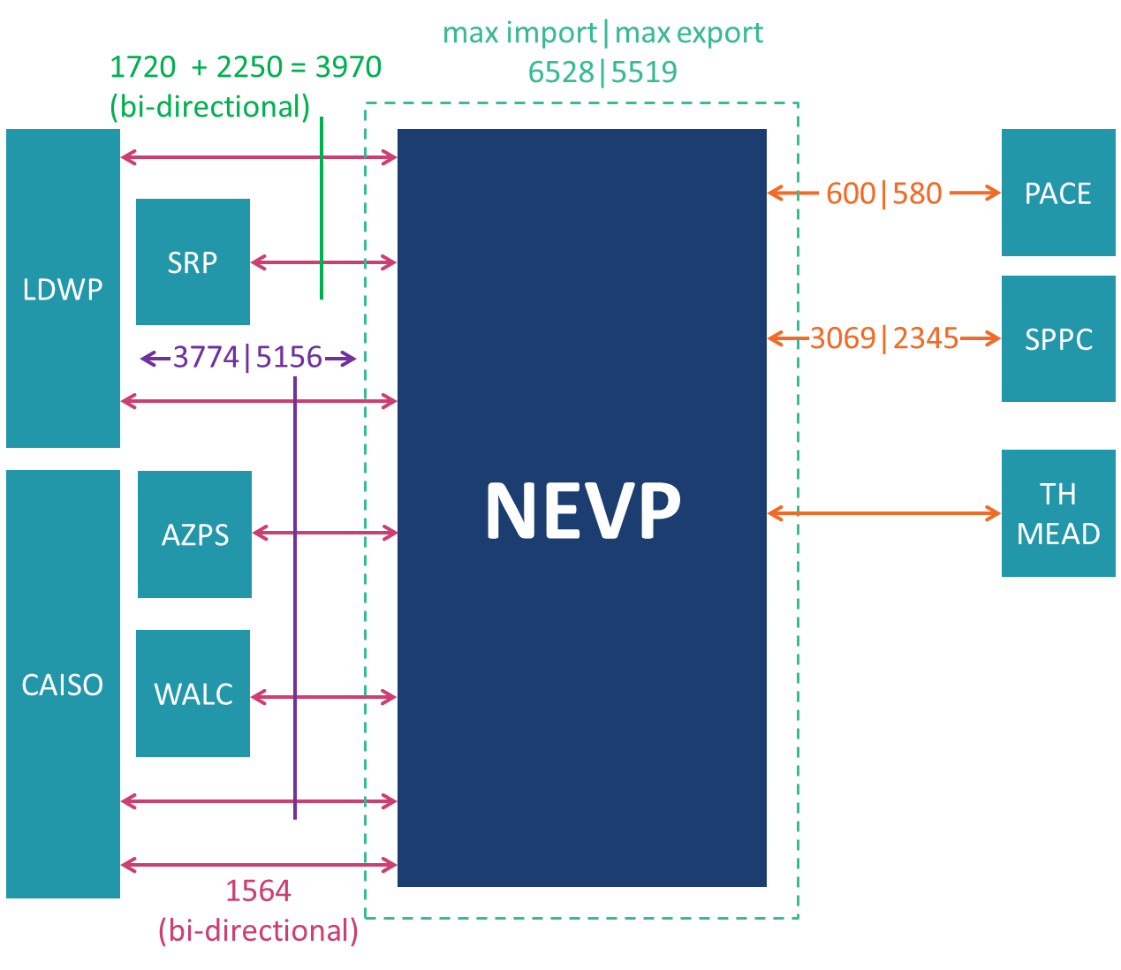
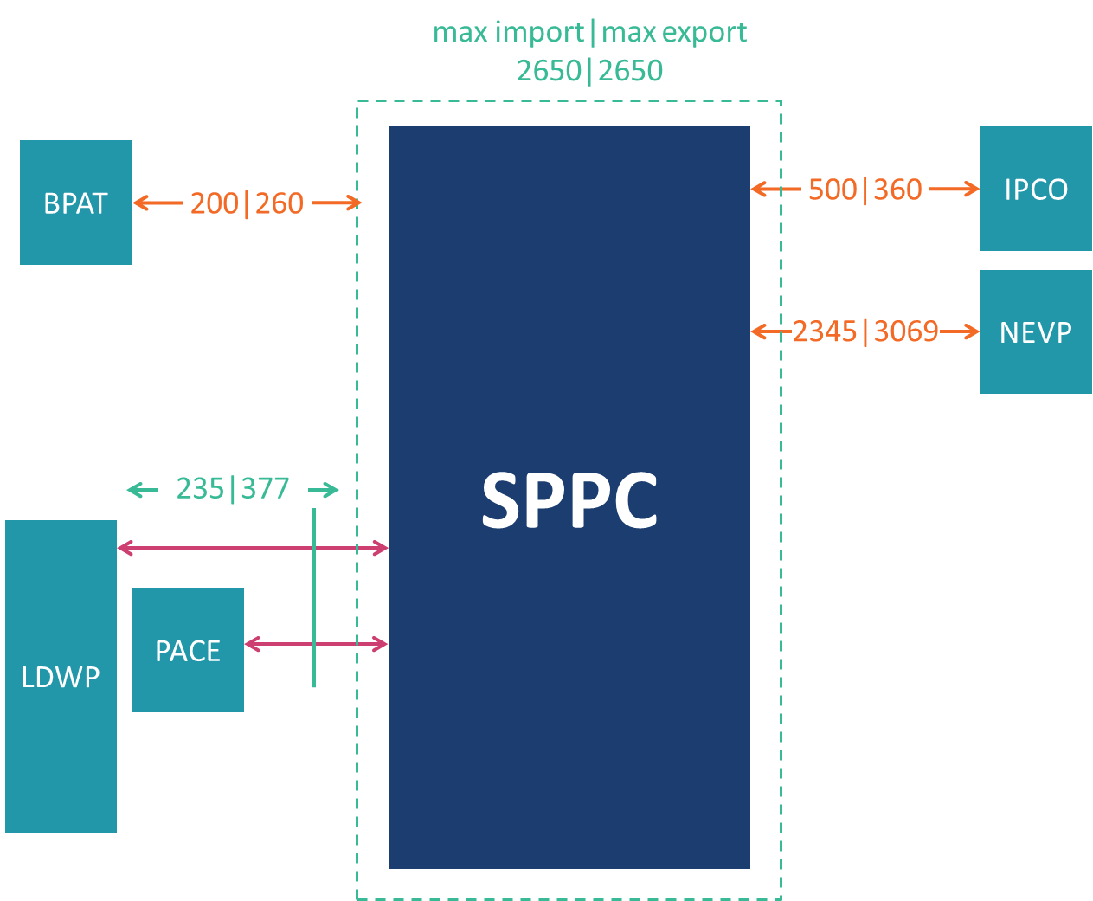
Contract Path Transfer Capacity
Appendix: NVE Modeling assumptions
  We model the trading of Nevada’s two subareas (NEVP and SPPC), as provided by NVE
  Bilateral and market trading is modeled with simultaneous physical limits
  Our EDAM/M+ cases assume all TTC is made available to the market
NVE-South (NEVP) Transfer Capability
NVE-North (SPPC) Transfer Capability
Note: diagrams show only the contract path constraints, WECC paths in the NVE service territories and other physical constraints were also modeled.

Slide 60
Appendix: EDAM Modeling Assumptions

Slide 61
Resource Sufficiency & Transmission
Appendix: EDAM Modeling assumptions
  Resource Sufficiency Test
  The EDAM design applies the Resource Sufficiency Test to each EDAM member the day prior to real-time, before day-ahead market operations
    In the 2019 EDAM Feasibility Study, E3 conducted an hourly analysis of Resource Sufficiency for each proposed EDAM member at that time
      In that analysis, failure of the test was extremely rare
      In fact, all current study participants (BANC, CAISO, IPCO, LADWP, SMUD, and PAC) previously passed the resource sufficiency test in all hours
    For this study, conducted ex-post check and confirmed that all assumed EDAM members are resource sufficient in all hours
  EDAM Transmission
  All three buckets of EDAM transmission are modeled and assumed to be hurdle-free:
    Bucket 1: Transmission to Support Resource Sufficiency
      Includes existing long-term transmission contracts (“ETCs”) for energy used for sufficiency accounting purposes
    Bucket 2: “Donated” Transmission Contracts
      Existing transmission contracts (ETCs) made available (“donated”) to the EDAM by participants
    Bucket 3: Unsold Firm Transmission
      Remaining transmission made available for EDAM (participants might hold back from transmission for block trading)
  Simulated Bucket 1 and 2 EDAM transmission equals total ETC capacity; Bucket 3 transmission equals the remaining transfer capability (i.e., TTC less ETC) between the assumed EDAM members

Slide 62
GHG Structure Illustration
Appendix: EDAM Modeling assumptions
Resources can sell into neighboring BAAs by paying applicable fees:
Bilateral market: OATT fee, trading margin
EIM: no hurdle on available transmission
EDAM: no hurdle on Buckets 1,2, & 3
Sales incur unit GHG cost, relevant hurdles, and are limited by attributions from the GHG Reference Pass
California
AZPS
PNM
BANC
Coal
Coal
(GHG = ~$75/MWh)
Resources serve load in their own BAA with no hurdle
CAISO
CTs
CTs
(GHG = ~$41/MWh)
Other
Other
(GHG = ~$27/MWh)
CCs
CCs
LADWP
(No GHG Hurdle)
Non-
Emit.
Non-
Emit.
Flows restricted to BAA export limit
+ BAA Net Export GHG Attribution Limit
A nomogram restricting total BAA-to-BAA flows to export limit, which varies by market type – bilateral, EIM, and EDAM

Slide 63
EDAM GHG Structure: “Reference Cycle”
Appendix: EDAM Modeling Assumptions
Our GHG modeling structure accounts for two constraints specified in the EDAM design for GHG attributions relative to a baseline from EDAM’s “reference pass” cycle, which we simulate as well
  Resource Specific GHG Attribution (resource-type attribution under proposed approach) =
  max{0, min{GHG Bid, UEL – Reference Pass, Optimal Dispatch}}
  BAA Total GHG Attribution <= (Net TTC Difference - BAA Net Exports hourly in reference pass)
These reference pass results set hourly export limits that are enforced in the actual EDAM case for EIM and EDAM members for sales to GHG balancing authorities
Simulations assume resources bid all their capacity into the GHG Region
Calculated using results of our GHG Reference Pass run
GHG attribution cannot exceed final dispatch of resource

Slide 64
Imbalance Reserve Requirement
Appendix: EDAM Modeling Assumptions
Imbalance Reserve is a new reserve product being implemented by the CAISO as part of their DA Market Enhancements (DAME) initiative, and will apply to EDAM
  The Imbalance Reserve requirement (up and down) will be set to meet the 97.5 percentile of each BAAs historical net load variability
  In EDAM, participants’ Imbalance Reserve Requirement will be reduced by the diversity benefit created by pooling commitment and dispatch across the regional footprint
  Does not impact other operating reserve types – regulation, contingency, etc.
  Brattle Assumption: we calculated each EDAM participants Imbalance Reserve Requirement and the EDAM diversity benefit to reduce each member’s requirement
EDAM reserve requirement estimated to fall about 2-4.2 GWh in the EDAM Case (relative to Base Case) due to the diversity benefit achieved by the EDAM footprint

Slide 65
Appendix: Markets+ Assumptions

Slide 66
Transmission Usage in the Market
Appendix: Markets+ Assumptions
Modeling Assumption: All transmission with other Markets+ entities was modeled as available for market transaction without any wheeling charges
  Brattle modeled BPAT consistent with their participation in WEIM, with limited transmission made available to the market
  We asked all study participants if you want to identify some transmission to set aside for WRAP, third party ownership, or other reasons.
    No study participants identified any WRAP transmission to be withheld from the market optimization

Slide 67
M+ GHG Structure
Appendix: Markets+ Assumptions
Based on our review of the draft tariff language and the task force materials posted online, we assume for the purposes of these studies that M+ will use the following approach:
  Only energy identified as GHG surplus will be available to transfer to the GHG zone
  GHG surplus identification will happen through the Resource Operator and Merit Order approach
    Rules from state agencies may restrict what resources can be identified as surplus energy by the resource operator
    Resource operators make all resources available for transfer to the GHG zone
    BA-level hourly surplus capacity available for transfer to the GHG transfer is calculated outside of the model using modeled load and a merit order constructed from modeled cost and capacity assumptions
    We apply type-specific GHG costs to surplus transfers to the GHG zone
  We assume the market optimization will use the “Enhanced Floating Surplus” approach
    This allows transfer of type-specific surpluses from anywhere in the dispatch range of eligible resource

Slide 68
Seams Management
Appendix: Markets+ Assumptions
Modeling Assumption: Brattle modeled the Markets+ seam consistent with the description from the Seams Task Force
  Exports into or imports out of Markets+ were charged a small bilateral friction charge plus the exporting entity’s wheeling rate
  This is consistent with how we model the CAISO seam in the BAU Case
  Exports across the Markets+ seam into a GHG zone are charged an unspecified resource GHG cost (equivalent to the emissions charge for a generic gas-CC unit)
    This makes Markets+ exports to CAISO and other GHG entities fairly expensive, as the GHG cost alone will be around $30/MWh
Modeled Trading Friction Charges ($/MWh)
Markets+ imports & exports pay either the bilateral or RTO intertie friction costs (RTO for trades with CAISO or SPP West, who connects to PACE)

Slide 69
Real Time Market
Appendix: Markets+ Assumptions
Brattle modeled Markets+ with a real-time market that operates like SPP’s Western Energy Imbalance Service (WEIS)
  At the time the study was conducted, the Markets+ Task Forces had not discussed how the real-time market would function, but it is expected that Markets+ would include a RT market
  This also provides an apples-to-apples comparison with EDAM/WEIM
  Real-time transactions at the Markets+ seam pay a small hurdle rate to capture bilateral friction + the exporting BAA’s wheeling free + applicable GHG costs
  Transactions in real time across GHG zones and between markets (e.g., from EDAM to Markets+ or from Markets+ to CAISO/EDAM are charged the unspecified GHG rate)
    For example, exports from CAISO to Markets+ are charged the CAISO TAC + hurdle rate
    Exports from Markets+ to CAISO are charged the GHG rate + exporter’s OATT rate + hurdle rate

Slide 70
Congestion Rent Allocation
Appendix: Markets+ Assumptions
Congestion revenues are allocated back to market participants consistent with proposed constraint-level approach
  The Markets+ proposed approach is to allocate congestion based on the portion of rights each market participant owns on the constraint where congestion is collected
  This differs from the EDAM model where tie points were used between BAs to determine the allocation of revenue between two BAs, splitting revenue into internal congestion revenue within a BA (kept by that BA), and transfer revenue between two BAs (split 50/50 between the BAs)

Slide 71
Market Transmission Use Settlement
Appendix: Markets+ Assumptions
Assumption: Brattle calculated the MTU settlement consistent with the proposed approach
  Brattle used 2032 modeled wheeling revenues in the BAU Case as a proxy for future lost transmission revenue that goes into the settlement calculation
  This differs from some of the original EDAM cases which used historic wheeling revenues provided by the clients as the basis for the EDAM TRR settlement

Slide 72
Appendix: Summer 2023 NVE EDAM Study Details

Slide 73
BAU Case Footprint
Appendix: Summer 2023 NVE EDAM Study Details
BCHA/
Powerex
AESO
  For the BAU case, Brattle assumes the day-ahead market will remain a bilateral market
  WEIM entities in teal
    Existing WEIM footprint modeled
  Original study EDAM BAU did not include the RTO West footprint
  Non-market BAs assumed to trade only bilaterally
PSEI
CHPD
AVA
DOPD
WAPA Upper Great Plains
SCL
GCPD
NWMT
BPA
TPWR
PGE
Idaho Power
WAPA CO/MO
PacifiCorp West
PacifiCorp East
CAISO
NV Energy
SMUD
Public Serv. CO
BANC
TIDC
WAPA Lower CO
SRP
PNM
AZPS
LDWP
CFE
IID
TEPC
EPE
Modeled as WEIM Member
Non-Market BA

Slide 74
EDAM Case Footprint
Appendix: Summer 2023 NVE EDAM Study Details
BCHA/
Powerex
AESO
  EDAM case assumed EDAM is the only DA market (no Markets+ footprint simulated)
  EDAM Entities in Blue
    TIDC would remain in WEIM
  Case did not include the RTO West footprint
  Non-market BAs assumed to trade only bilaterally
PSEI
CHPD
AVA
DOPD
WAPA Upper Great Plains
SCL
GCPD
NWMT
BPA
TPWR
PGE
Idaho Power
WAPA CO/MO
PacifiCorp West
PacifiCorp East
CAISO
NV Energy
SMUD
Public Serv. CO
BANC
TIDC
WAPA Lower CO
SRP
PNM
AZPS
LDWP
CFE
IID
TEPC
EPE
EDAM and WEIM Member
WEIM-Only Member
Non-Market BA

Slide 75
NVE EDAM Study Benefits Results
Appendix: Summer 2023 NVE EDAM Study Details
In the initial EDAM study, Brattle simulated Nevada Power in a BAU case with no day-ahead WECC markets and Nevada Power in a limited EDAM footprint
  Modeled benefits for Nevada Power joining EDAM totaled $101.3 million
  NV Benefits were driven by:
    Adjusted Production Cost savings of $84 million/yr
    EDAM congestion and transfer revenues of $32 million/yr
    Increased short-term non-firm wheeling revenues of $24 million/yr
    Losses in bilateral and EIM congestion revenues totaling $26.5 million
    A net EDAM TRR settlement loss of $12 million
Summary of NVE EDAM Participation Impacts
$ Million

Slide 76
NVE EDAM Adjusted Production Cost Benefit
Appendix: Summer 2023 NVE EDAM Study Details
NVE Adjusted Production Cost falls $84 million/year from the EDAM case:
  Increased gas generation raises production costs by $71 million/year
  Reduced day-ahead purchase costs due to reduced prices as NVE buys excess renewables in the EDAM footprint, lower costs by $33 million/year
  The increased sale volume and prices (mostly the increased gas generation) in the day-ahead market raises day-ahead sales revenues by $188 million/year
(1)
(2)
(3)

Slide 77
NVE EDAM Revenues
Appendix: Summer 2023 NVE EDAM Study Details
Nevada’s EDAM revenues mostly come from congestion revenues with CAISO and LDWP. These revenues are driven by the large trading volumes, not as much by high price separation
  Nevada trades about 26 TWh with CAISO, LDWP, IPCO, and PACE at an average EDAM transfer + congestion revenue value of about $1.2/MWh to NVE
EDAM Congestion + Transfer Revenues to NVE
This table does not include NVE EDAM trading hub transactions which yield less than $100k in revenue.

Slide 78
Appendix: Fall 2023 NVE Markets+ Study Details

Slide 79
BAU Case Footprint
Appendix: Fall 2023 NVE Markets+ Study Details
BCHA/
Powerex
AESO
  The Original Markets+ case has market footprints identical to the new Bookend Markets+ case
  Markets+ in Orange
    Includes all U.S. BAAs in WECC, except for California entities and PAC
    Also includes entities in RTO West (WACM, WAUW, PSCO), which is cooptimized with Markets+
    Entities that join Markets+ assumed to leave WEIM and join an SPP-run RT market similar to WEIS
  EDAM Entities in Blue
    TIDC would remain in WEIM
  IID, CFE, and AESO assumed to trade only bilaterally
PSEI
CHPD
AVA
DOPD
WAPA Upper Great Plains
SCL
GCPD
NWMT
BPA
TPWR
PGE
Idaho Power
WAPA CO/MO
PacifiCorp West
PacifiCorp East
CAISO
NV Energy
SMUD
Public Serv. CO
BANC
TIDC
WAPA Lower CO
SRP
PNM
AZPS
LDWP
CFE
IID
TEPC
EPE
Modeled as SPP West RTO
Modeled as WEIS Member
EDAM and WEIM Member
WEIM-Only Member
Non-Market BA

Slide 80
Markets+ Case Footprint
Appendix: Fall 2023 NVE Markets+ Study Details
BCHA/
Powerex
AESO
  The Original Markets+ case has market footprints identical to the new Bookend Markets+ case
  Markets+ in Orange
    Includes all U.S. BAAs in WECC, except for California entities and PAC
    Also includes entities in RTO West (WACM, WAUW, PSCO), which is cooptimized with Markets+
    Entities that join Markets+ assumed to leave WEIM and join an SPP-run RT market similar to WEIS
  EDAM Entities in Blue
    TIDC would remain in WEIM
  IID, CFE, and AESO assumed to trade only bilaterally
PSEI
CHPD
AVA
DOPD
WAPA Upper Great Plains
SCL
GCPD
NWMT
BPA
TPWR
PGE
Idaho Power
WAPA CO/MO
PacifiCorp West
PacifiCorp East
CAISO
NV Energy
SMUD
Public Serv. CO
BANC
TIDC
WAPA Lower CO
SRP
PNM
AZPS
LDWP
CFE
IID
TEPC
EPE
Modeled as SPP RTO West
Markets+ (DA and RT) Member
EDAM and WEIM Member
WEIM-Only Member
Non-Market BA

Slide 81
NVE Markets+ Benefits Results
Appendix: Fall 2023 NVE Markets+ Study Details
Brattle estimated NVE’s benefits from joining Markets+
  The Markets+ case showed an NVE net benefit of $5m
    APC and transfer revenues are high for NVE, but low overall benefit due to large EIM and bilateral losses that accrued when NVE joined Markets+ (NVE moves from WEIM to WEIS in this scenario)
Summary of Nevada Benefits ($ Millions)

Slide 82
NVE Markets+ Adjusted Production Cost Benefit
Appendix: Fall 2023 NVE Markets+ Study Details
NVE is seeing a net APC benefit of $40 million, driven by:
  (1) Reduced thermal generation saving $114 million in production costs (replaced by market purchases)
  (2) Increased market purchases, costing $55 million in both day-ahead and real-time to replace reduced generation
  (3) Increased day ahead sales volumes and revenue, with average sales prices going up $2.5/MWh and sales volumes increasing 1.3 TWh
  (4) Reduced real time sales revenue due to exit from EIM, costing $92 million from 2.1 TWh of lost sales volumes
(1)
(2)
(3)
(4)
Loss of EIM sales revenue (-$92 million) partly offset by increase in Markets+ sales revenue ($73 million)

Slide 83
NVE Markets+ Revenues
Appendix: Fall 2023 NVE Markets+ Study Details
NVE’s Markets+ revenues mostly come from congestion revenues with IPCO and BPAT. These revenues are driven by transfers aiming to use NVE’s system to get to the Northwest portion of the market
  Nevada trades about 14.5 TWh with AZPS, BPAT, IPCO, SRP, and WALC at an average Markets+ value of about $4.4/MWh
Markets+ Congestion and Transfer Revenues to NVE
This table does not include NVE Markets+ trading hub transactions which yield less than $100k in revenue.

