Slide 1





Surplus Plus Enhancement Education Session
June 13, 2025
Steve Purdy
technical Director Engineering Policy
Working together to responsibly and economically keep the lights on today and in the future.
SouthwestPowerPool
SPPorg
southwest-power-pool

Slide 2

Purpose
Describe Surplus Plus Initiative
Describe Priority Processing and review key tariff changes
Answer questions
Review approval process and next steps

Slide 3
SURPLUS
PLUS OVERVIEW

Slide 4
Surplus Plus
What is it?
A suite of initiatives to accelerate the addition of generating resources in alignment with SPP’s corporate goals
Why is it needed?
Expedite projects with limited impact
Make efficient use of existing infrastructure
Reduce impact to GI queue
Make existing processes more efficient and user-friendly
Bolster resource adequacy

Slide 5
Surplus Plus Components
Phase 1: Now-October
Phase 2: Now-January
Priority Processing (July MOPC)
Surplus-Replacement Enhancements (October MOPC)
  Process to establish service capacity for legacy/non-GIA generators
  Relax ownership transfer restrictions for generator replacement
  Process for phased replacement via surplus/replacement
  Clarify existing surplus/replacement applications
  Extend timeline for generator replacement for forced outage (RR563)
Process Coordination
  GI, Transmission Service, Market Registration, Resource Adequacy, Operations
  Reduce redundancy
  Harmonize processes
  Single source of “truth”
Modification Improvements
  Clarify application of tariff processes
  Address typical use cases to streamline processing

Slide 6
SURPLUS PLUS PHASE 1:
PRIORITY
PROCESSING

Slide 7
Phase 1: Priority Processing
What is it?
New process to quickly add incremental capacity at existing generating facilities
Permanent add to tariff
Respects queue priority
Limited to “shovel-ready” projects
Why is it needed?
Bolster resource adequacy
Expedite projects with limited impact
Make efficient use of existing infrastructure
Reduce impact to GI queue

Slide 8
Priority Processing: Key Eligibility Provisions
Connect at an existing POI (like Surplus & Replacement)
Co-located or sited contiguous to an existing generating facility
Requested by existing generating facility owner/s
Shovel-ready
Show major equipment is on order
Show 100% site control for generating facility & tie line
Show permits & certificates are in-hand or in-progress & attainable
Show 100% financing secured
Plan commercial operation within 5 years of submission with standard GIA extension permitted
Study deposits 1.5x DISIS
Financial Security One 2x DISIS
Capacity increase limited to 20% over existing capacity
A second request at the same POI can’t be made within 12 months of the first request

Slide 9
Priority Processing: Key Process Provisions
Serial processing – not clustered
Queue priority ahead of requests in current open window (haven’t yet started study)
Same fuel-based dispatch as DISIS
Same impact analysis as DISIS: steady-state, stability, short-circuit in a single 90-day phase
Same facilities study as existing
Same directly assigned cost allocation as existing GI

Slide 10
Priority Processing: Benefits & Risks
Benefits
Risks/Drawbacks
Request any time - No need to wait for an open window
Impact results in 90 days –
  No wait for cluster study to start
  No study delay due to volume of other requests in cluster
Costs tied only to impact of request - not driven by other requests in cluster
Bear 100% of upgrade costs and study costs –
  No cost sharing with other requests
  No capacity sharing with other requests
  No upgrade optimization
No GRID-C cost-certainty
Restudies could increase

Slide 11
Priority Processing: Timeline
From request to GIA, Priority Processing is faster than DISIS by a minimum 140 days to as much as 16 months, restudies not included
Aug | Sep | Oct | Nov | Dec | Jan | Feb | Mar | Apr | May | Jun
≤172d
Priority SIS 90d
PDP
IFS 60d
Request
PSIS Study Report
IFS Study Report
GIA
Advantage over DISIS: 140d to 505d
11mo
≤312d
Open Window
Review 30d
DISIS P1 60d
DP1
DISIS P2 120d
DP2
IFS 60d
Request
DISIS Study Report
DISIS Study Report
IFS Study Report
GIA

Slide 12
Priority Processing: Tariff Revision Index
Attachment V: Generator Interconnection Procedures
Section 1 Definitions
Section 3 Interconnection Requests
Section 4 Interconnection Request Evaluation Process
Section 8 Definitive Planning Phase
Section 9 Affected System Study
Section 11A Interim Generator Interconnection
Section 12 Construction of Interconnection Facilities
Appendix 3 GI Study Agreement
Appendix 5 Interim Study Agreement
Appendix 8 Interim GIA
Appendix 14 Interim GIA for WAPA

Slide 13
Priority Processing: New Definitions
Priority Processing shall mean accelerated processing available to Interconnection Requests that meet the requirements under the GIP.
Priority Request shall mean an Interconnection Request that is submitted requesting Priority Processing under the GIP.
Priority Decision Point shall mean the period of time following the posting of the results of the Priority System Impact Study.
Priority System Impact Study (PSIS) shall mean an engineering study that evaluates the impact of the proposed interconnection on the safety and reliability of Transmission System and, if applicable, an Affected System. The study shall identify and detail the system impacts that would result if the Generating Facility were interconnected without project modifications or system modifications, or that may be caused by the withdrawal or addition of an Interconnection Request, or to study potential impacts, including but not limited to those identified in the Scoping Meeting as described in the Generator Interconnection Procedures.
Priority System Impact Study Restudy (Priority Restudy, PSIS Restudy) shall mean a restudy of a Priority System Impact Study conducted pursuant to Section 8.8 of this GIP.

Slide 14
Priority Processing: Attach V Section 3
3.1.3 Describes Priority Processing (new)
3.4 Validation process for Priority Requests
3.6 Includes Priority Requests in affected system procedures
3.8 Ensures contingent facilities are identified for Priority Requests
3.10 Includes Priority System Impact Study in the penalties for missing study deadlines
3.11 Additional Requirements for Priority Processing (new): request must
  Be made by owner/affiliate of existing facility. Joint owners must consent.
  Be same site or adjacent & contiguous as existing facility.
  Have 100% tie line site control
  Have same POI as existing facility
  Show major equipment has been ordered and will be delivered timely
  Show permits & certificates are in-hand or can be obtained
  Show 100% financing
  Plan COD in 5 years or less
  Request no more than 20% additional capacity over existing facility

Slide 15
Priority Processing: Attach V Section 4
4.1.1 Priority Requests are queued ahead of requests in an open DISIS window
4.2.2 Upgrade cost allocated 100% directly-assigned
4.4 Addresses modifications
4.6 Addresses technological changes

Slide 16
Priority Processing: Attach V Section 8
8.1 Existing Generator Interconnection Study Agreement
8.2 Can submit at any time
  Additional site control requirements
  Extra study deposit (50% extra)
  Extra financial security (100% extra)
  Commercial Operation Date within 5 years from submission
8.3 Validation review period
8.4 One-phase impact study
8.5 Impact study in 90 days after receipt of all requirements
8.5.3 Decision Point to move to Facilities Study
8.8 Impact restudy
8.14(h) Withdrawal refunds – securities are 100% at-risk and refunded if no harm to lower-queued requests

Slide 17
Priority Processing: Attach V Other
Section 9: Add Priority Requests to affected system study
Section 11A and Appendix 5, 8, 14: Allow Priority Request to satisfy requirement for requesting Interim Service
Section 12: Allow for update of Priority System Impact Study when accelerated
Appendix 3 GI Study Agreement: Incorporate Priority Requests

Slide 18
Priority Processing: Approval Process
Month | Date | Event | Outcome
June | 13 | Education Session
 | 17 | Post RR for comment
 | 24 | TWG Vote
 | 26 | RTWG Vote
July | 15 | MOPC Vote
August | 5 | Board (if appealed)

Slide 19
Priority Processing: Questions

Slide 20
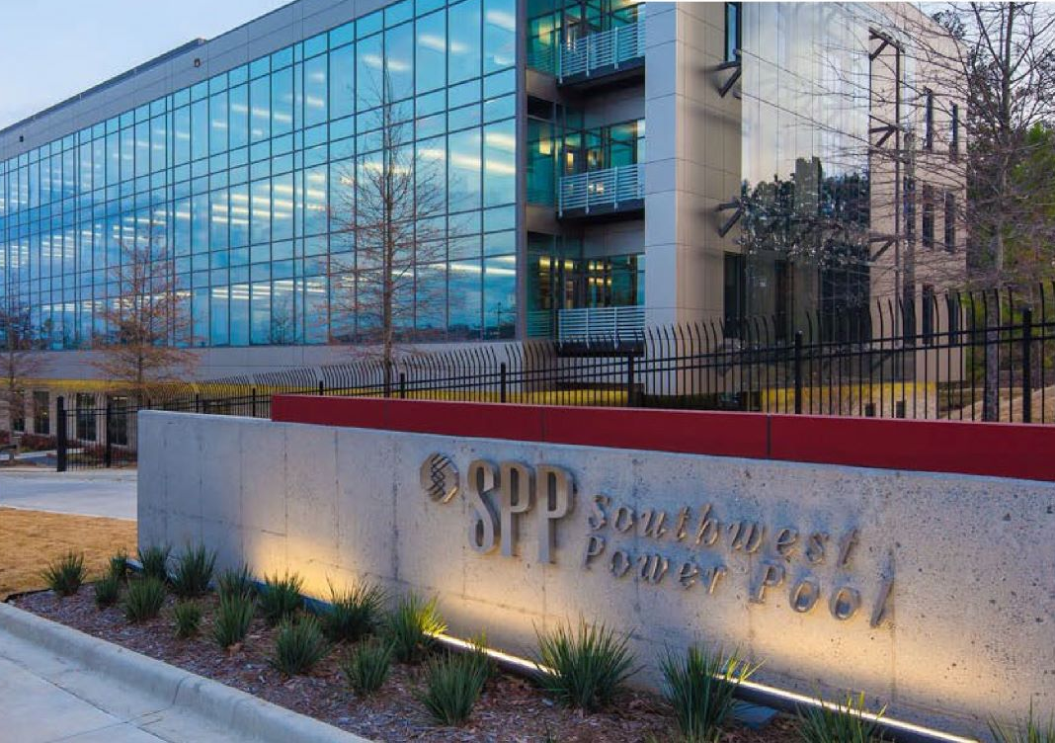
Steve Purdy
Technical Director Engineering Policy
spurdy@spp.org
501-614-3371

